Slide 1
Aristotelis Styanidis (DC14)
&
Ajay IYER (DC5)
Sleepiness on the Road: Integrating Physiological, Behavioural, and Vehicle-Based Indicators
IVORY Conference Athens

Slide 2
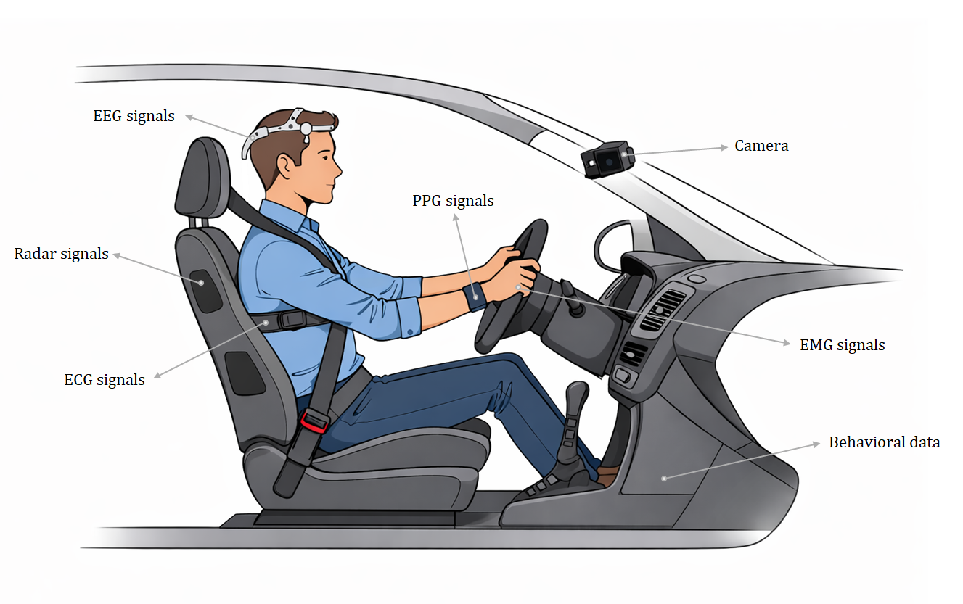
Driver Drowsiness Monitoring
Notes:
Drowsiness monitoring is possible with different types of data. These data can either be physiological,

Slide 3
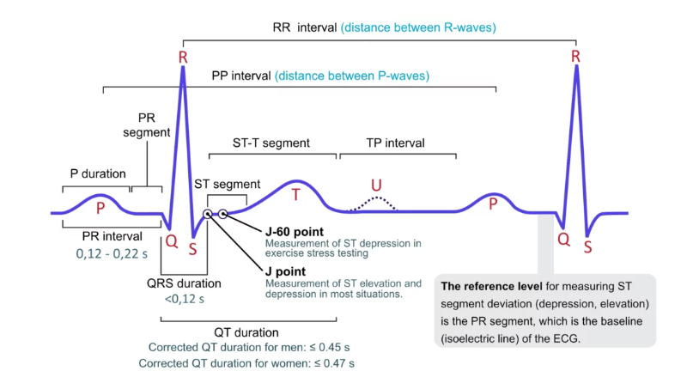
QRS Complex
Autonomous Nervous System (ANS) controls the heart and comprises:
  Sympathetic Nervous System: “fight or flight” system
  Parasympathetic Nervous System: “feed and breed” system
Wakefulness: Increase in sympathetic and/or
decrease in parasympathetic
Relaxation: Increase in parasympathetic and/or
decrease in sympathetic
Notes:
I will first talk about the QRS complex in ECG.
As sleepiness increases, heart rate becomes lower but also irregular and blood pressure drops [21]. Autonomic Nervous System (ANS) controls the heart, and since system activity changes with extreme fatigue and drowsiness, so does the heart [24]. ANS has two branches that in most of situations have opposite actions: sympathetic nervous system (“fight or flight” system) and the parasympathetic nervous system (“feed and breed” system) [25]. Wakefulness states are characterized by an increase in sympathetic and/or a decrease of parasympathetic activities, while relaxation states are characterized by an increase in parasympathetic and/or a decrease in sympathetic activities [24, 26, 27].

Slide 4
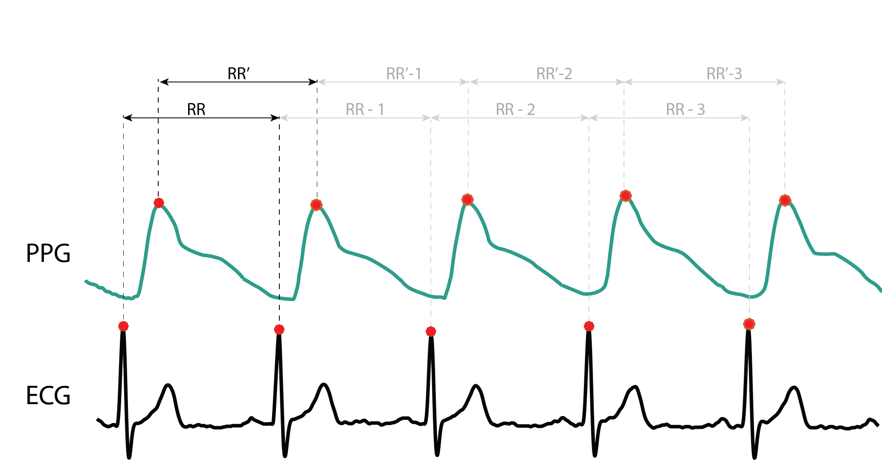
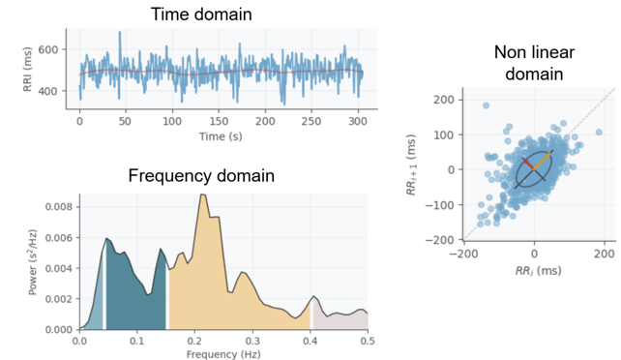
The Physiological Perspective - ECG
R-peak detection and Inter-Beat Interval (IBIs) or RR interval extraction
Pan-Tompkins algorithm
Heart Rate Variability (HRV) describes variations of both instantaneous heart rate and intervals between two consecutive R peaks.
HRV Feature Extraction:
  Time domain features: SDNN, RMSSD, SDSD, etc.
  Frequency domain features: LF, HF, LF/HF, etc.
  Non Linear domain features: Poincare plot parameters, entropy-based features
Notes:
These activities can be measured by means of the heart rate variability (HRV) signal obtained from surface electrocardiogram (ECG) or from a photoplethysmogram (PPG) [28]. Regarding ECG (Figure 2.2), HRV signal describes variations of both instantaneous heart rate and intervals between two consecutive R peaks of the ECG [29], called RR intervals, and therefore, as the focus on the driving task decreases and heart rate becomes more irregular, HRV increases [30].

Slide 5
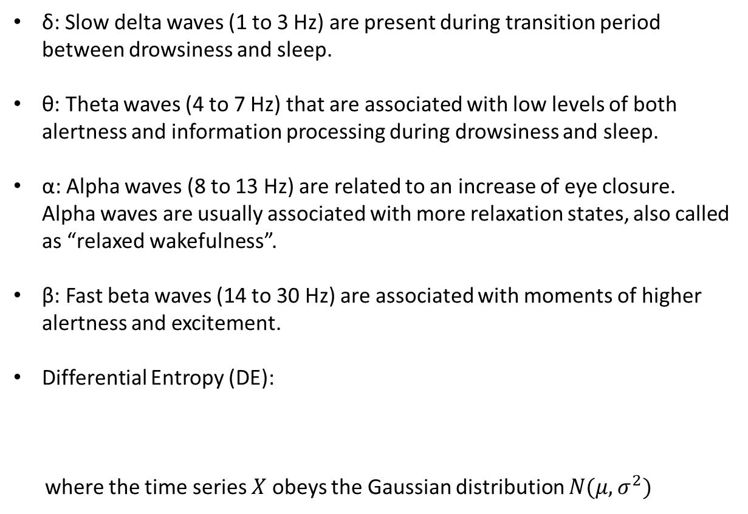
The Physiological Perspective - EEG
δ: Slow delta waves (1 to 3 Hz) are present during transition period between drowsiness and sleep.
θ: Theta waves (4 to 7 Hz) that are associated with low levels of both alertness and information processing during drowsiness and sleep.
α: Alpha waves (8 to 13 Hz) are related to an increase of eye closure. Alpha waves are usually associated with more relaxation states, also called as “relaxed wakefulness”.
β: Fast beta waves (14 to 30 Hz) are associated with moments of higher alertness and excitement.
Differential Entropy (DE):
where the time series $X$ obeys the Gaussian distribution $N(μ, σ^{2})$
$$h\left(X\right)=−\int_{−∞}^{∞}{\frac{1}{\sqrt{2πσ^{2}}}exp\frac{{\left(x−μ\right)}^{2}}{2σ^{2}}\log_{ }{(\frac{1}{\sqrt{2πσ^{2}}}exp\frac{{\left(x−μ\right)}^{2}}{2σ^{2}})}dx}=\frac{1}{2}\log{(2πeσ^{2})}$$
Notes:
EEG Differential Entropy (DE) measures the complexity of continuous EEG signals, often used as a superior feature to power spectral density for emotion recognition and vigilance estimation. It represents the logarithmic energy in specific frequency bands (delta, theta, alpha, beta, gamma) and assumes a Gaussian distribution of EEG signals, usually calculated defined as the following equation.

Slide 6
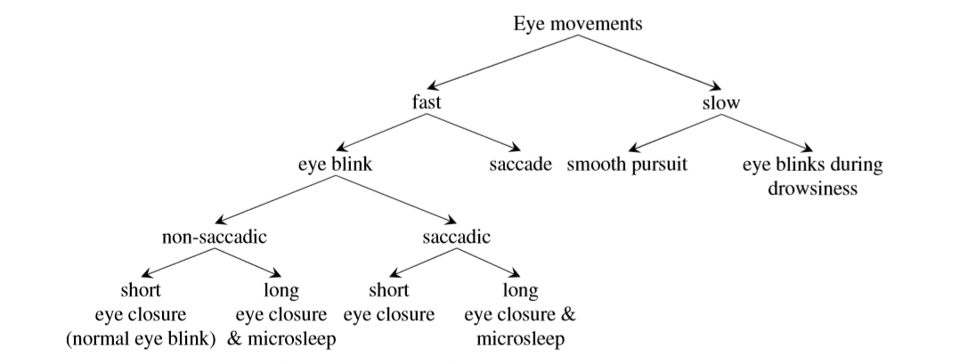

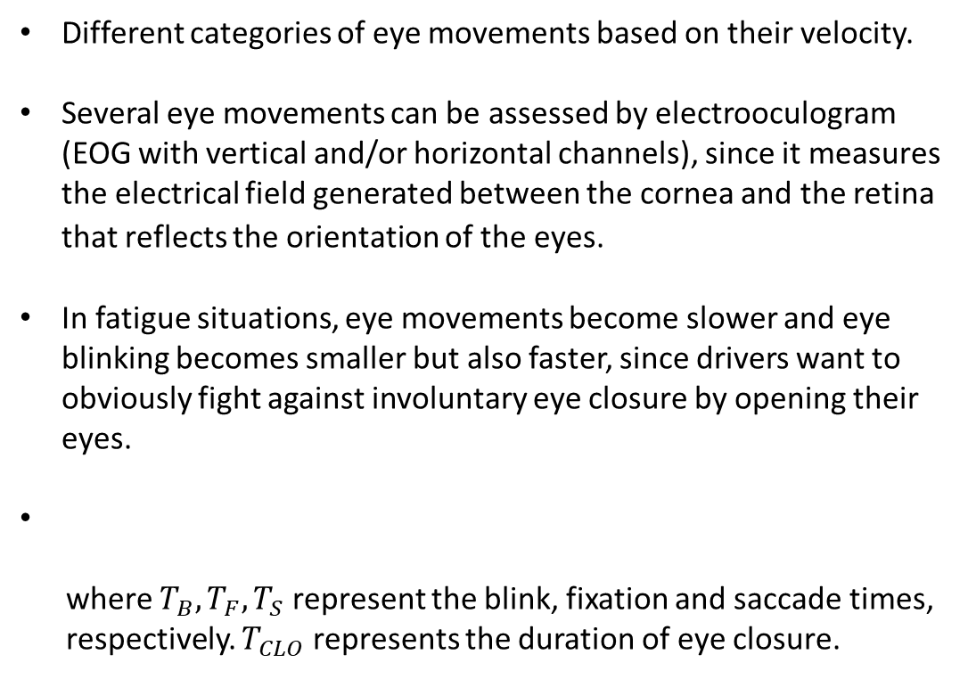
The Physiological Perspective - EOG
Different categories of eye movements based on their velocity.
Several eye movements can be assessed by electrooculogram (EOG with vertical and/or horizontal channels), since it measures the electrical field generated between the cornea and the retina that reflects the orientation of the eyes.
In fatigue situations, eye movements become slower and eye blinking becomes smaller but also faster, since drivers want to obviously fight against involuntary eye closure by opening their eyes.
where $T_{B},T_{F},T_{S}$ represent the blink, fixation and saccade times,
respectively. $T_{CLO}$ represents the duration of eye closure.
$$PERCLOS=\frac{T_{B}+T_{CLO}}{T_{B}+T_{F}+T_{S}+T_{CLO}}$$
Notes:
The PERCLOS score is a widely recognized and crucial metric for fatigued driving. Prior studies have also leveraged the PERCLOS as a label in EEG based fatigued driving analyses. Essentially, this metric represents the proportion of time during which the degree of eye closure surpasses a certain threshold in a given time unit. The PERCLOS is a number between 0 and 1; the closer the value is to 0, the longer the duration of effective eye closure in the time unit is, hence indicating a greater level of fatigue in the subject. Given that the fatigue level of the user changes gradually and smoothly without interference, we apply a smoothing process to the calculated PERCLOS values.

Slide 7
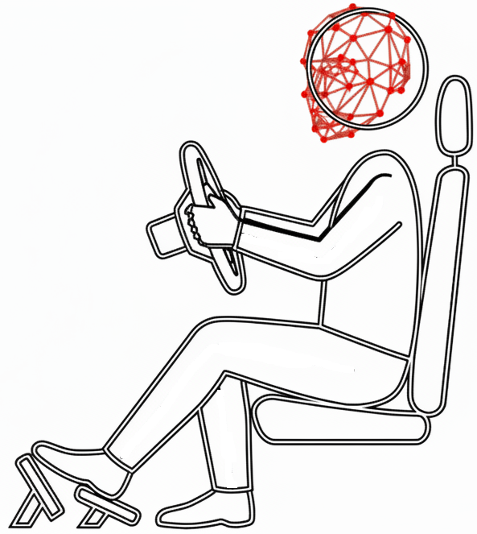


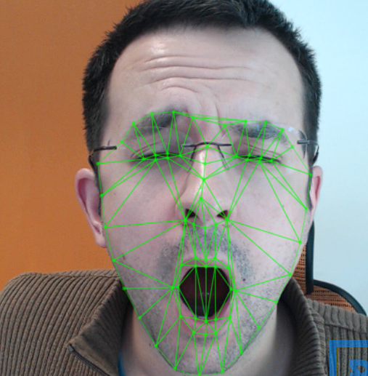
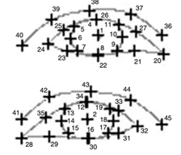
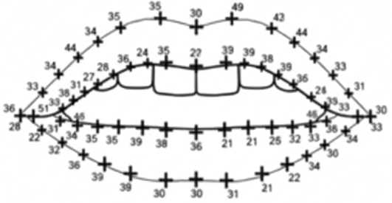
The Visual Perspective – Naturalistic Video Analysis
Transition from internal physiological states to external behavioral manifestations
Cross-Modal Drowsiness
Detection and Validation
Leveraging large-scale video-based Naturalistic Driving Database (NDD)
Capturing under real-world environmental variability: lighting, occlusion, head pose.
Focusing on non-intrusive extraction of ocular and facial markers.
Visual data can act as observable confirmation for drowsiness.
Notes:
**Point 1:** “My colleague has shown us the power of the internal physiological signals for measuring and detecting drowsiness. My research complements this internal physiological drowsiness detection by focusing the on the external behavioral manifestations—what the drowsiness actually *looks* like in the real world." *
**Point 2:** "I utilize a comprehensive Naturalistic Driving Database. Unlike simulated environments, this data captures the messy reality of daily driving, providing the necessary context to validate the physiological models." *
**Point 3:** ".Where The detection algorithm must perform robustly across changes in lighting, from bright sunlight to pitch black night, and handle natural occlusions like hands or glasses." *
**Point 4:** “My focus is on non-intrusive monitoring. Using standard dashcam footage, I am extracting ocular markers without requiring the driver to wear additional hardware, t." *
**Point 5:** "Crucially, the video serves as our observable ground truth. While a physiological siganal processing can strongly indicate drowsiness and fatigue. The Visual manifestations confirms it. Hence use this visual data indicators to label and verify the physiological predictions."

Slide 8
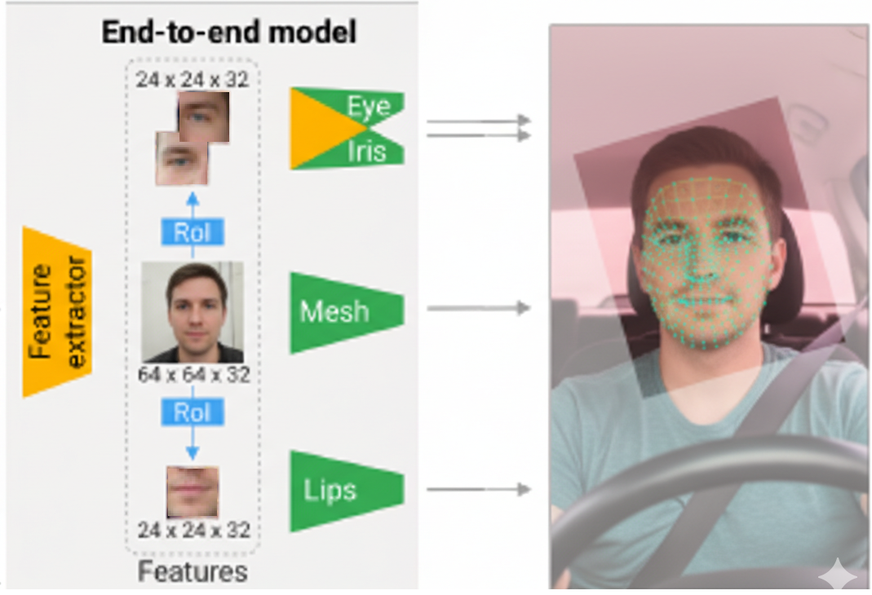
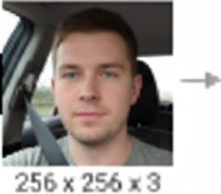

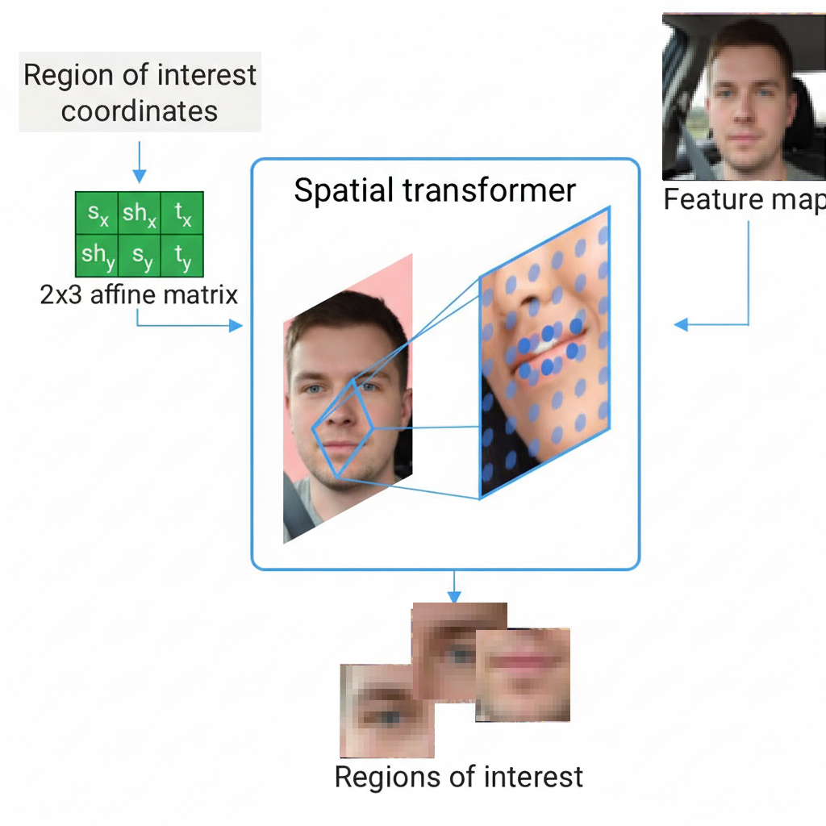
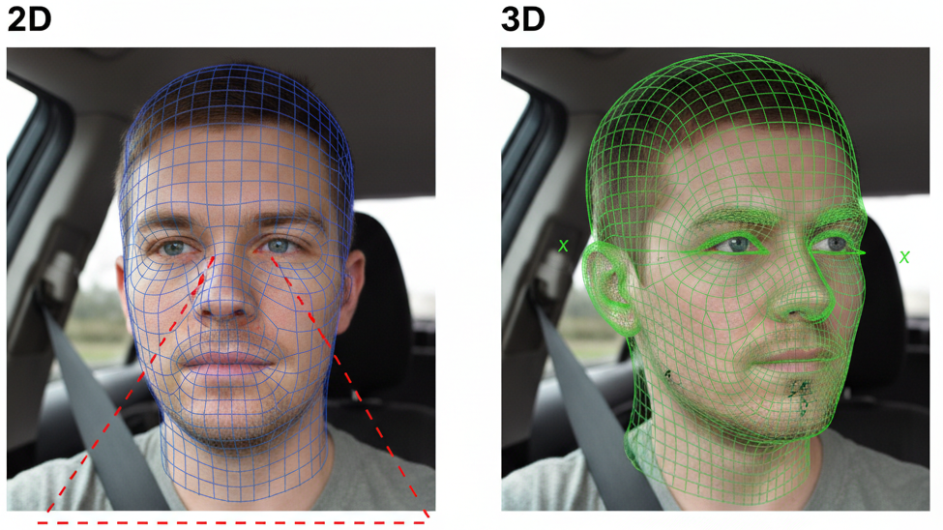
Vision based Drowsiness Monitoring-3D Facemesh
Lightweight Residual CNN architecture optimized for real-time inference
Attention Mesh mechanism performs direct 3D coordinate regression.
Predicts (n)- 3D landmarks (x, y, z) bypassing 2D heatmaps.
3D geometry estimation ensures consistency during extreme head rotations.
2D heatmap errors
Improved 3D landmark accuracy
Notes:
A quick look at the model that is used:
**Point 1:** “The implementation utilizes a customized version of MediaPipe’s FaceMesh. It employs a lightweight Residual CNN backbone, specifically optimized to run at high FPS on edge devices without GPU acceleration." *
**Point 2:** "this architecture uses an 'Attention Mesh' mechanism it performs direct regression to predict the $x, y, z$ coordinates of the facial vertices using the regression loss formula shown, *
*Point 3:** Compared to earlier architectures that relied on 2-D heatmaps to calculate depth."The network predicts a vector of 468 landmarks in 3D space ($x, y, z$). This regression loss method provides This depth component with high accuracy and it allows us to understand the face's geometry, not just its flat projection." *
**Point 4:** The critical advantage of 3D regression is geometric invariance. In a 2D mesh, if a driver turns their head, the distance between eye landmarks shrinks due to perspective (foreshortening), triggering false drowsiness alerts

Slide 9
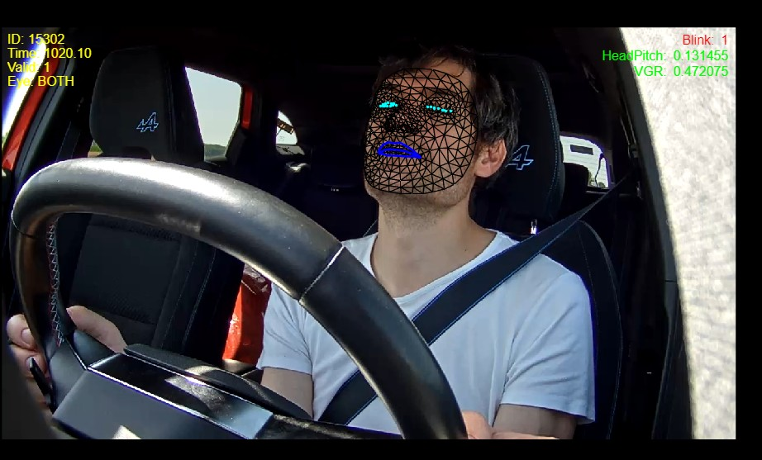
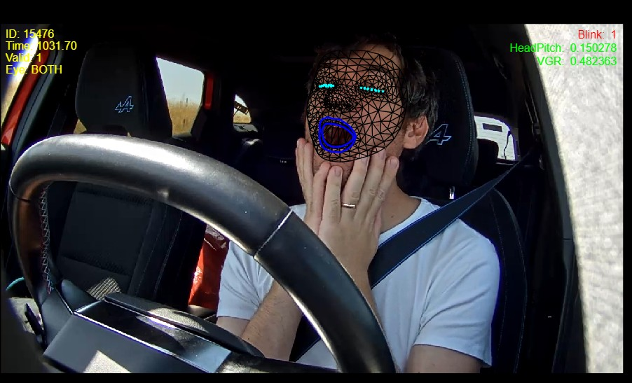

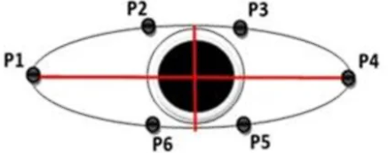

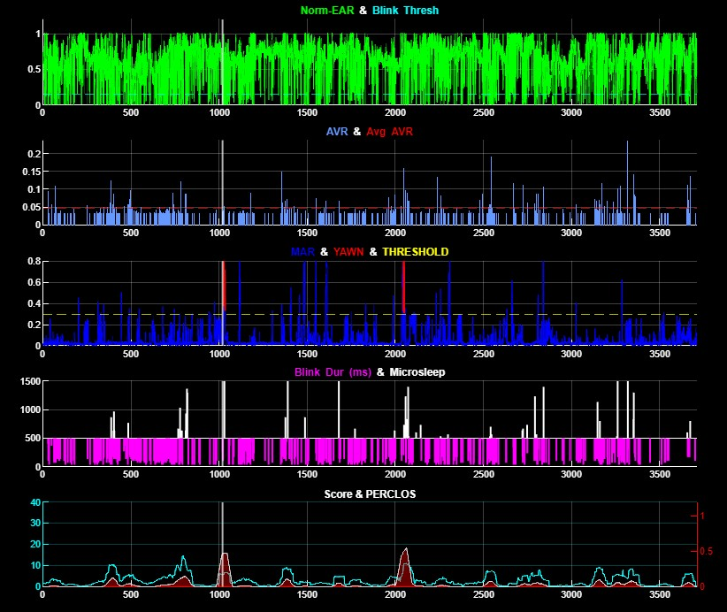
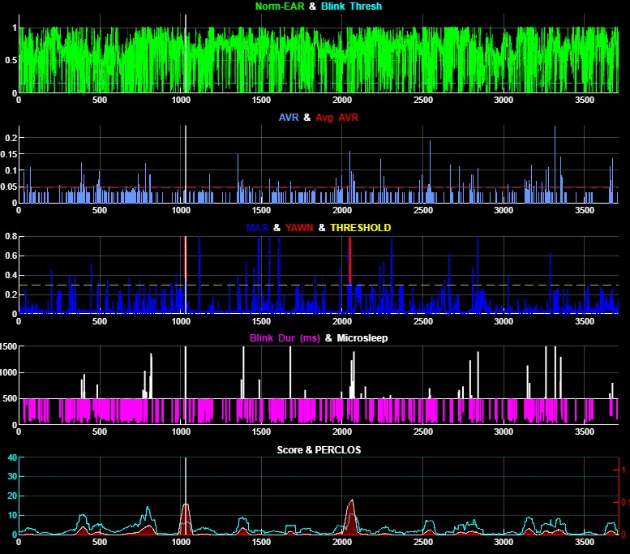


Signal Processing & Adaptive Baselines
Physics-based signal generation transforming raw landmarks into Eye/Mouth Aspect Ratios
Adaptive 5-minute moving baseline normalizes inter-driver variability.
Signal Peak Detection on EAR/MAR and "Min-Then-Max" search algorithm delimits blink duration
Amplitude-Velocity Ratio (AVR) calculates true blink reopening phases.
Generates high-dimensional vector to track PERCLOS, Yawn Density, Microsleeps etc
Notes:
**Point 1:** " The next step is processing the raw mesh using physics-based formulas to generate the Eye Aspect Ratio (EAR) and Mouth Aspect Ratio (MAR), as continuous signals of eye openness and yawning." *
**Point 2:** “The focus is on adaptive baselines, so a 5-minute initialization time is used establish a baseline, followed by a moving average. This adapts the model to the specific driver's natural physiology, A 5-minute moving window constantly updates the 'open state' reference, normalizing the signal for each specific driver."
**Point 3:** “A , a signal peak detection algorithm and a 'Min-Then-Max' search algorithm on the EAR is used to identify true blinks. We look for the peak closing velocity (min) and the peak reopening velocity (max).This precisely delimits the start and end of a blink, allowing us to measure duration with millisecond precision
**Point 4:** Amplitude-Velocity Ratio (AVR) is also calculated using the formula shown. Drowsy blinks have a distinctive sluggish reopening velocity compared to their closure amplitude.
**Point 5:** “These signals are used to generate metrics and track critical drowsiness indicators like PERCLOS, AVR,Yawn Density and specific Microsleep events (closures > 500ms),
These metrics are fed into a weighted scoring algorithm that generates the weighted score.

Slide 10
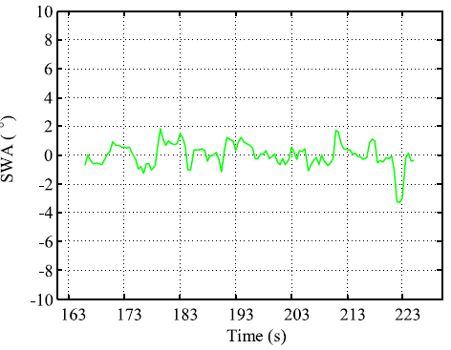
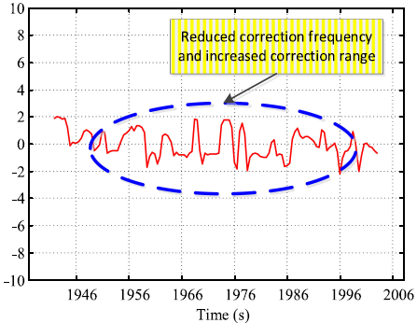

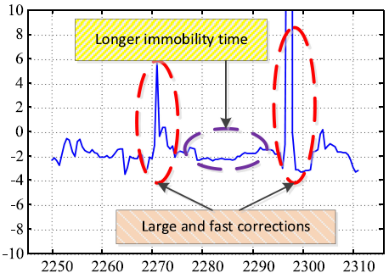
Vehicle Kinematics Supporting Detection
Vehicle kinematics serve as supporting detection and validation artifacts.
Awake
Moderately Drowsy
^{[1]}
^{[1]}
Steering Entropy(H_{p})quantifies control unpredictability and drowsiness induced performance degradation
^{[1]}
Extremely Drowsy
Models such as shapelet discovery and LSTM can identify drowsy state steering patterns
Kinematic based anomalies can confirm drowsiness when visual/physio confidence is low.
[1]: Li et al., 2022
Notes:
* **Point 1:** "Inaddition to Visual Driver drowsiness indicators, Kinematic features can also act as a third detection layer. If the driver is visually drowsy, the car's movement should reflect that loss of control.“
* **Point 2:** "Steering Entropy (based on Zhang et al.) analysis has shown to be a good indicator of drowsiness and fatigue. As drowsiness sets in,we see the drivers correction frequency reduces and correction range increases and they make fewer micro-corrections, and finally in extreamley drowsy mode it leads to 'flat' steering followed by jerky over-corrections.
Entropy quantifies this unpredictability." *
**Point 3:** "Using Multivariate Time Series Analysis, we apply Motif Discovery to find 'Shapelets.' These are specific geometric shapes in the steering signal can be detected and tracked." Similarly Long Short-Term Memory (LSTM) networks can model the sequence of steering corrections learn the temporal evolution of these steering features." *
**Point 4:** “These methods related to car kinematics are useful validations, because in scenarios where vision is blocked (darkness) or physiology is noisy (movement), a spike in Steering Entropy can confirm the onset of drowsiness."

Slide 11
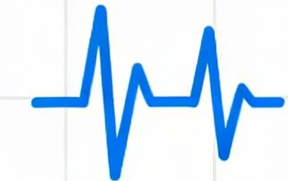

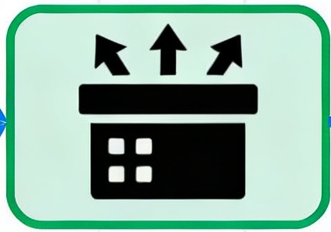
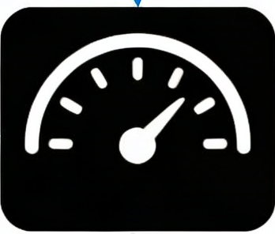

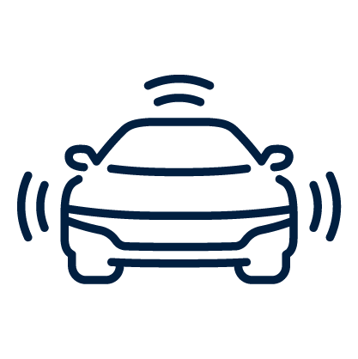
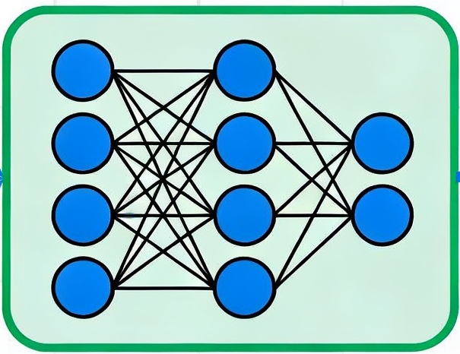
Synergy and Multimodal Future
Fusing Physiological + Visual + Kinematic signals for holistic safety
Physiology can detect early onset
Vision detects and confirms drowsiness state;
Kinematics supports drowsiness driving context
Ensemble Majority voting
Drowsiness Score
Best Integration strategies: Fusion Architectures and Ensemble Learning
  Fusion combines features for deep representation learning
  Ensembles weight independent models for robustness.
AI/ML Models
Drowsiness Score
Multimodal sensing provides better detection reliability in all environments
Neural Network
Notes:
**Point 1:** "Our conclusion and work for the future is towards a holistic framework. We are starting to move beyond single-sensor reliance to fusion of Internal Biology (Physio), External Behavior (Vision), and Physical Consequence (Kinematics)." *
**Point 2:** "The synergy between these three is temporal: Physiology offers the earliest warning of autonomic onset. Vision provides the observable confirmation of the drowsy state. Kinematics driver control signals can act as supporting validation." *
**Point 3:** The future is to investigate different integration strategies. 'Fusion Architectures' concatenate features to learn deep relationships (e.g., how HRV drops relate to Blink Rate). Conversely, 'Ensemble Learning' keeps models independent, allowing us more transparency and explainability." *
**Point 4:** "Ultimately, Multimodal sensing having independent modalities, guarantee reliability across all environment.

Slide 12
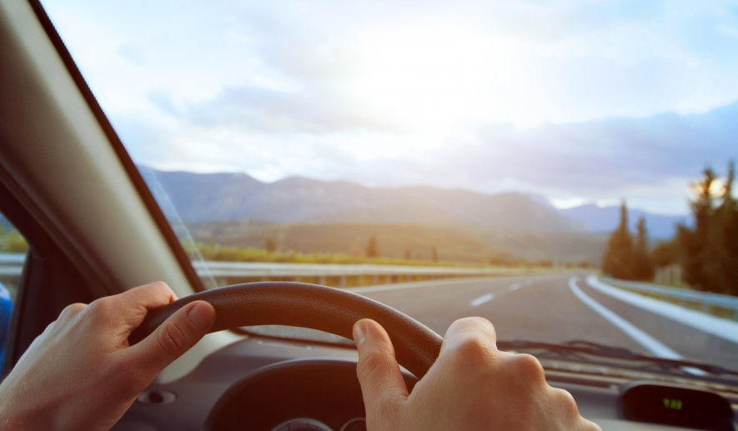
Thank you for your attention

Slide 13
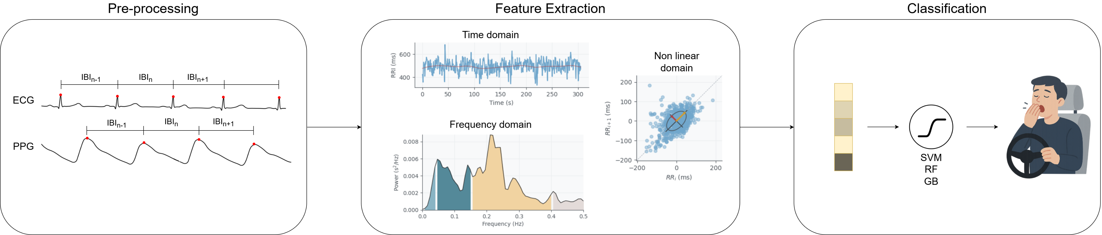
The Physiological Perspective
Pre-processing
Feature Extraction
Feature Selection
Classification
Prediction
Notes:
**Point 1:** “My colleague has shown us the power of the internal signal for measuring and detecting drowsiness. However, driving is a visual task. My research complements this by focusing on the external behavioral manifestations—what the drowsiness actually *looks* like in the real world." *
**Point 2:** "I utilize a comprehensive Naturalistic Driving Database. Unlike simulated environments, this data captures the messy reality of daily driving, providing the necessary context to validate the physiological models." *
**Point 3:** "The challenge here is variability. Our algorithms must perform robustly across drastic changes in lighting, from bright sunlight to pitch black night, and handle natural occlusions like hands or glasses." *
**Point 4:** "We focus on non-intrusive monitoring. Using standard dashcam footage, we aim to extract high-fidelity ocular markers without requiring the driver to wear additional hardware, bridging the gap to consumer deployment." *
**Point 5:** "Crucially, the video serves as our observable ground truth. While a heart rate change suggests fatigue, a closed eye confirms it. We use this visual data to label and verify the physiological predictions."

Slide 14
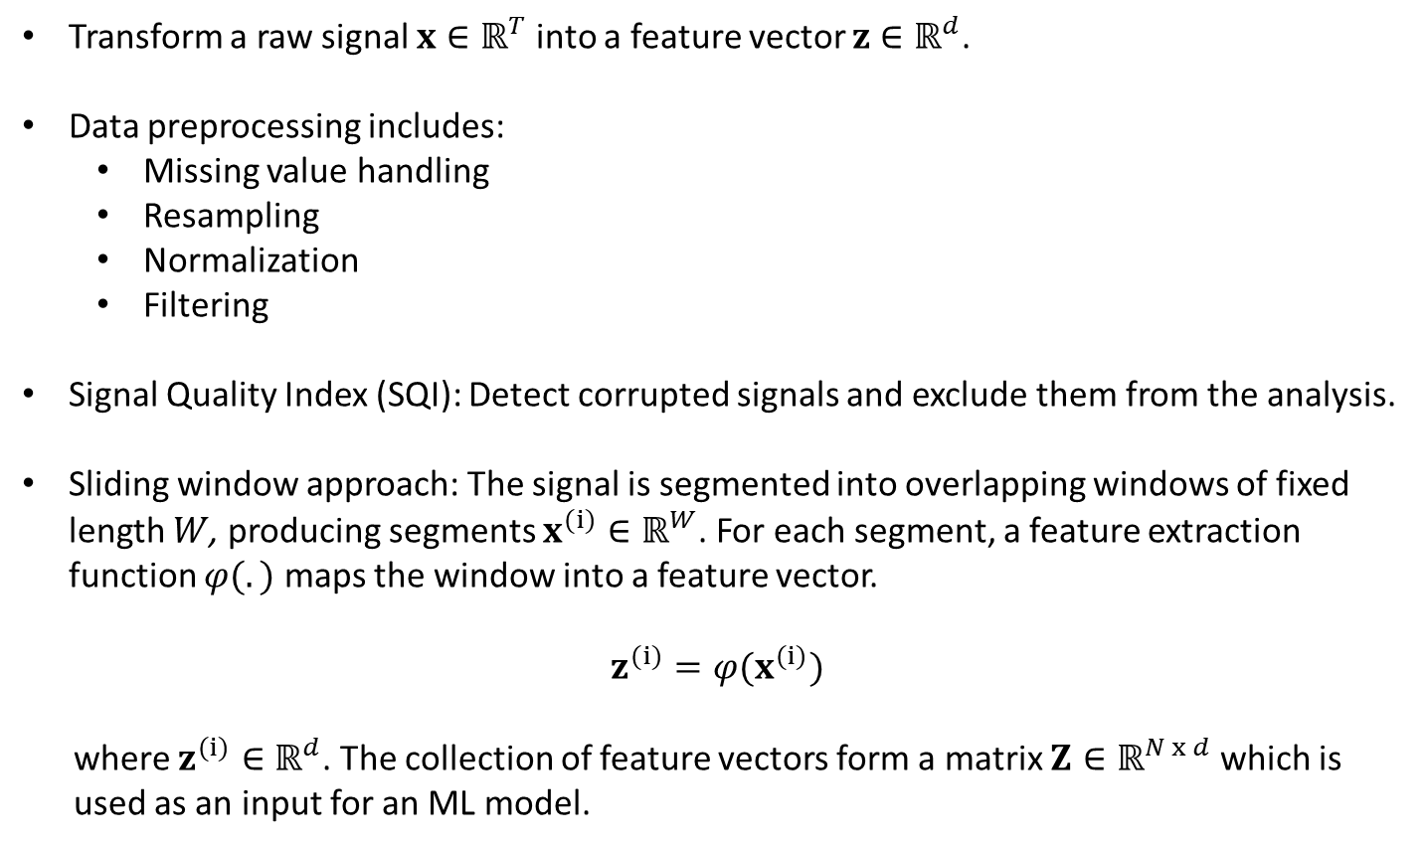
Feature Engineering with Physiological Signals
Transform a raw signal $x∈ℝ^{T}$ into a feature vector $z∈ℝ^{d}$.
Data preprocessing includes:
  Missing value handling
  Resampling
  Normalization
  Filtering
Signal Quality Index (SQI): Detect corrupted signals and exclude them from the analysis.
Sliding window approach: The signal is segmented into overlapping windows of fixed length $W$, producing segments $x^{(i)}∈ℝ^{W}$. For each segment, a feature extraction function $φ(.)$ maps the window into a feature vector.
$$z^{(i)}=φ(x^{(i)})$$
where $z^{(i)}∈ℝ^{d}$. The collection of feature vectors form a matrix $Z∈ℝ^{N x d}$ which is
used as an input for an ML model.
Pre-processing
Feature Extraction
Feature Selection
Classification
Prediction
Notes:
This one will go to the other session most probably… along with an image

Slide 15
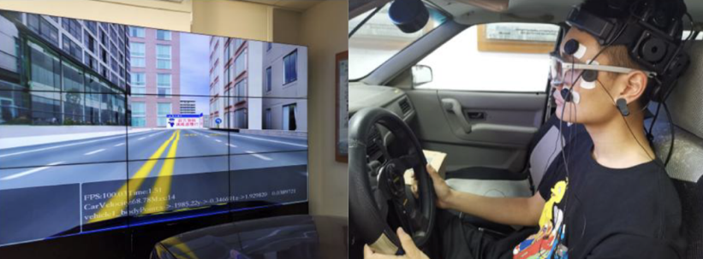
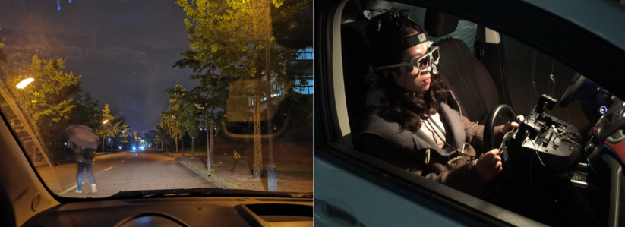
The Physiological Perspective
Domain shift: Real world conditions vs simulation
Notes:
**Point 1:** “My colleague has shown us the power of the internal signal for measuring and detecting drowsiness. However, driving is a visual task. My research complements this by focusing on the external behavioral manifestations—what the drowsiness actually *looks* like in the real world." *
**Point 2:** "I utilize a comprehensive Naturalistic Driving Database. Unlike simulated environments, this data captures the messy reality of daily driving, providing the necessary context to validate the physiological models." *
**Point 3:** "The challenge here is variability. Our algorithms must perform robustly across drastic changes in lighting, from bright sunlight to pitch black night, and handle natural occlusions like hands or glasses." *
**Point 4:** "We focus on non-intrusive monitoring. Using standard dashcam footage, we aim to extract high-fidelity ocular markers without requiring the driver to wear additional hardware, bridging the gap to consumer deployment." *
**Point 5:** "Crucially, the video serves as our observable ground truth. While a heart rate change suggests fatigue, a closed eye confirms it. We use this visual data to label and verify the physiological predictions."

