Slide 1
IVORY Conference Athens
Adaptive Driver Behaviour and Driver State Monitoring in Naturalistic Driving
Ajay IYER (DC5)
Mohammad Pashaee (DC6)

Slide 2
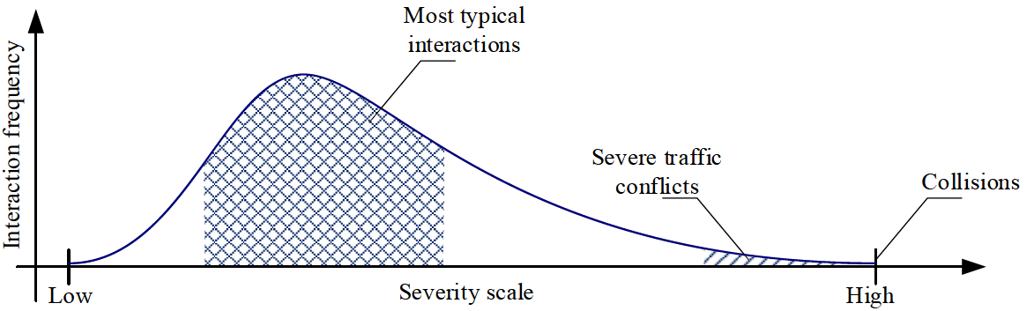
Introduction
Driving is a dynamic control task under uncertainty
Safety is maintained through ongoing behavioral adaptation
Safety-II
Successful Interactions
Instead of asking why drivers fail, we ask how they usually succeed
A. Tejada, J. Manders, R. Snijders, J.-P. Paardekooper, and S. de Hair-Buijssen, “Towards a Characterization of Safe Driving Behavior for Automated Vehicles Based on Models of ‘Typical’ Human Driving Behavior,” in 2020 IEEE 23rd International Conference on Intelligent Transportation Systems (ITSC), Sep. 2020, pp. 1–6. doi: 10.1109/ITSC45102.2020.9294184.
Notes:
If we look at the graph of frequency of traffic interaction with the severity of the interaction, we will see that although crashes and conflicts have high severity, but they have a small fraction of the all interaction. Most of the traffic interactions consisted of typical interaction road users interact with each other without risk elevation. Although most of the research on road safety usually focus on the crashes and near misses or conflicts, what can we learn by looking at the majority of the interaction that nothing serious related to safety is not happening.
Core message:
Traditional road safety work often focuses on crashes, conflicts, or violations. But real-world driving is mostly made of continuous adjustments to changing demands. Safety emerges when drivers adapt successful
Speaker idea:
“Instead of asking only why drivers fail, we ask how drivers usually succeed — and how that success varies in quality across contexts.”
Safety-I treats safety as the absence of adverse outcomes. Safety-II treats safety as the presence of adaptive capacity under variable conditions.
Driving is a dynamic control task under uncertainty
Safety is maintained through ongoing behavioral regulation
Observable behavior reflects internal adaptation to external constraints

Slide 3


Behaviour Adaptation
Adaptation Episode: A time-bounded behavioural response to changing interaction process.
(t₁)
(t₂)
Car-following Scenario
$$Vrel\text{=}\text{Vego}\text{−}\text{V}\text{target} >0$$
Adaptation Episode: A structured rise followed by recovery in relative velocity during car-following.
$$Vrel:$$
Notes:
How can we identify successful and degraded adaptation in naturalistic driving?
Core message:
DC6 aims to detect, characterize, and compare patterns of driver adaptation across the behavioural spectrum. Rather than isolated time points, adaptation should be studied as a temporal process.

Slide 4

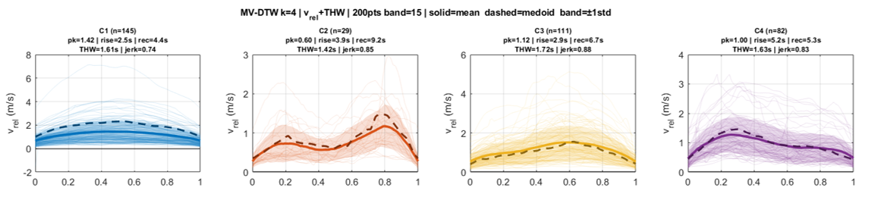
Behaviour Adaptation
Number of Drivers
20
Driving
Statistics
Number of Scenarios
866
365 Episodes
Total Hours
~ 6.7
DTW (V_{rel} + THW)
Notes:
Cluster 1: Symmetric regulation. The first cluster is the dominant cluster (n = 145), representing the most frequently observed adaptation pattern. Episodes in this cluster are characterised by relatively higher peak Vrel values, with rapid rises and recoveries. As shown in Fig. 3, both rise and recovery are concentrated at lower values compared to other clusters. This pattern may reflect a reactive form of adjustment in which the driver response quickly to the developing interaction and restores the situation within a short time window.
Cluster 2: Delayed adaptation. This cluster combines the lowest peak Vrel values with the longest recovery durations and has the fewest episodes (n = 29). The feature distributions confirm the shift toward longer recovery times, while rise durations remain moderate. In addition, the mean temporal profile of Vrel shows a bimodal shape, suggesting that the interaction evolves in two phases rather than a single continuous adjustment. This pattern reflects a mild disturbance that is regulated slowly, suggesting a cautious or delayed adjustment rather than an immediate response.
Cluster 3: Moderate adaptation. Episodes (n=111) in this cluster show a mean peak Vrel of 1.12m/s, a rise duration of 2.9s, and a recovery duration of 6.7s. Compared to Cluster 1, recovery is longer, but not as prolonged as in Cluster 2. The distributions indicate a balanced pattern, in which drivers respond to the interaction in a controlled manner, without either rapid correction or prolonged regulation.
Cluster 4: Slow buildup. The last cluster (n=82) is distinguished by the longest rise duration (5.2s), combined with a recovery duration of 5.3s and a mean peak Vrel of 1m/s. The defining feature is therefore the gradual development of the interaction before recovery begins. This pattern is consistent with a gradual adjustment, in which the closing process builds slowly, and the driver regulates it without a sharp transition.

Slide 5

Behaviour Adaptation
Shifting from Safety-I to Safety-II
Four distinct temporal adaptation patterns
Considering more drivers
Adding contextual effect (e.g. Traffic intensity)
Notes:
four distinct temporal regulation patterns, representing different ways in which drivers manage a closing interaction. These patterns differ in how the interaction develops and is resolved. Some episodes are handled quickly and efficiently, while others involve delayed or gradual responses. This indicates that variation in everyday driving is primarily expressed through timing rather than intensity.
But adaptive performance depends on internal capacity
The driver may face the same external demand, but adaptive performance changes depending on cognitive and physiological availability.
what happens when the internal capacity required for that adaptation is degraded?

Slide 6

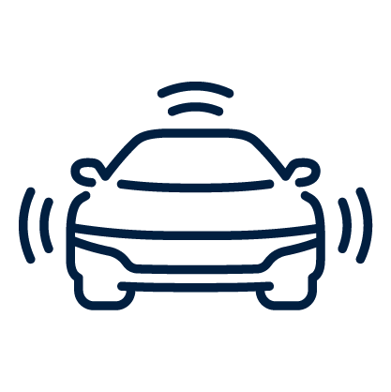

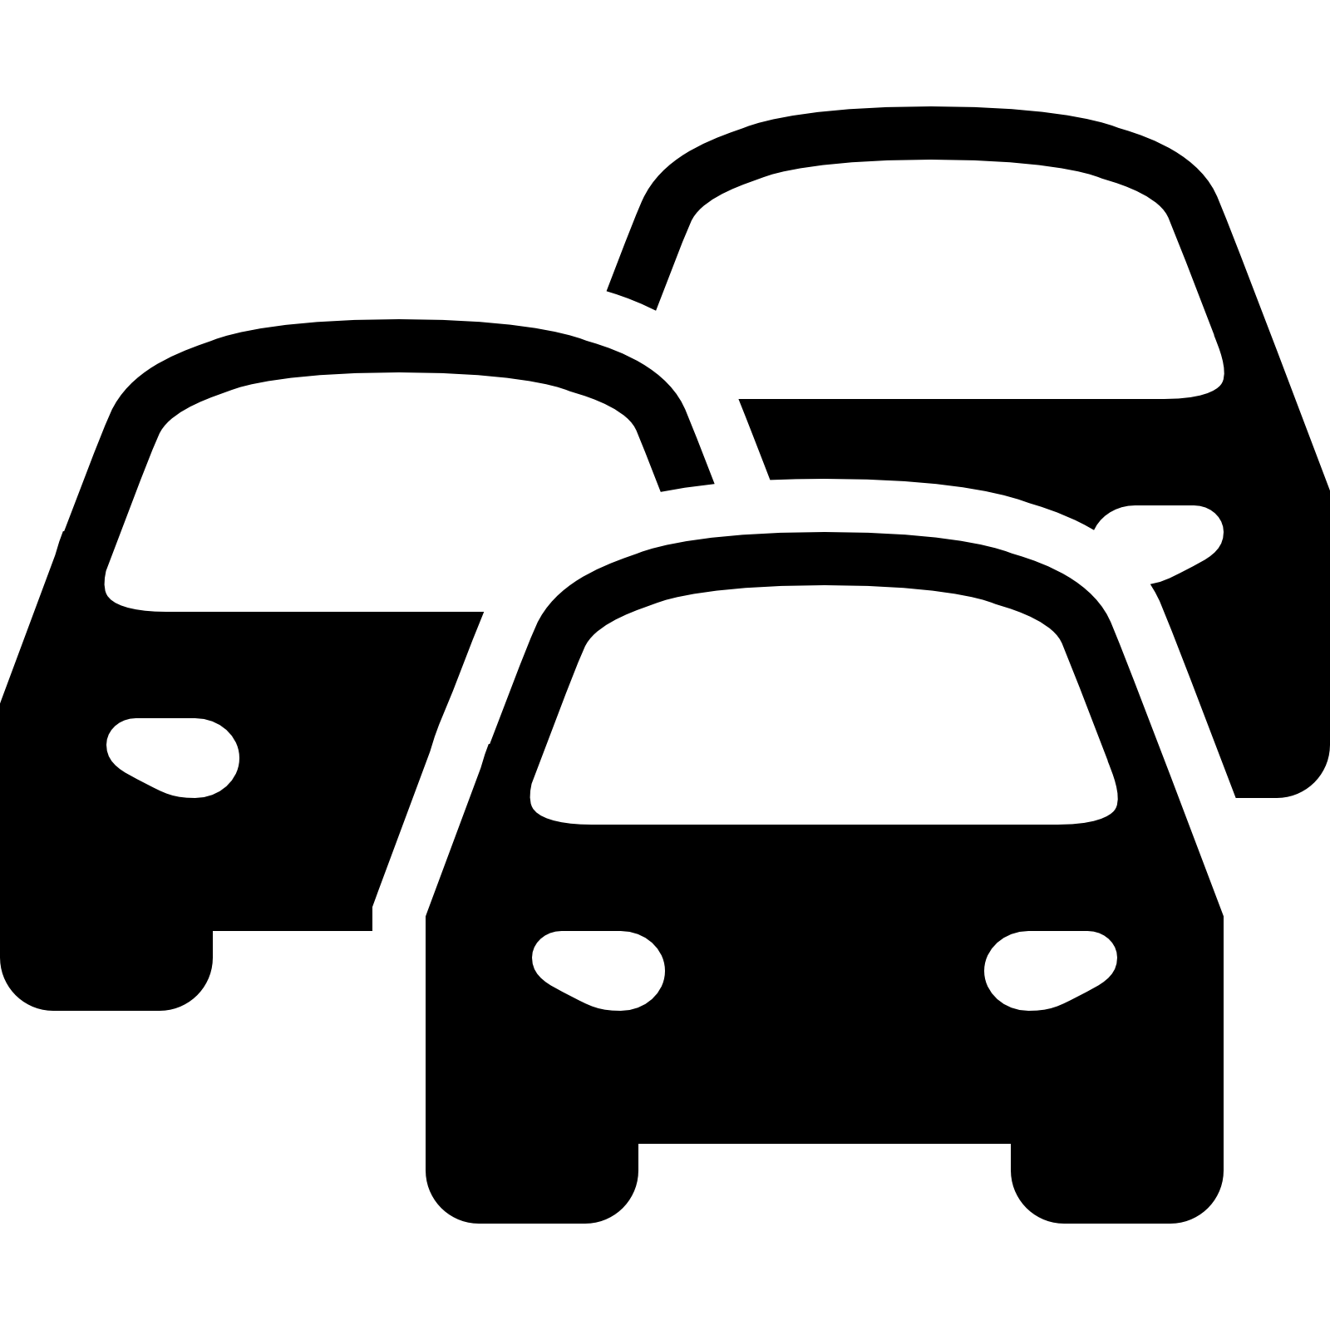


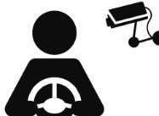




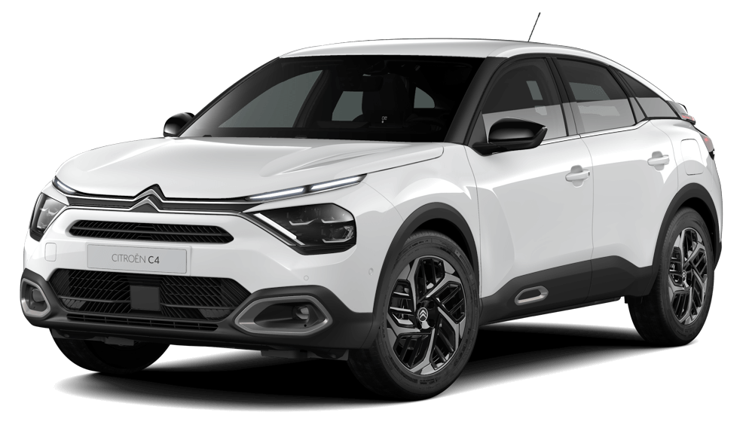
Driver States Impacting Behavioral Adaptation
  Behavioral States Affecting Drivers Internal Capacity:
Distraction: Attentional diversion toward competing non-driving tasks that affects driving safety ^{[1]}
Drowsiness: State of Increased sleep propensity due to inadequate rest, circadian factors, or task-induced fatigue compromising driving safety ^{[2]}
DDD Precursors: An Observable systematic behavioral/physiological temporal patterns that consistently precedes and signals the increased likelihood of Distracted /Drowsy state
Higher
Objective Driver
Capability
Task Demand/
Driver Capability
Actual margin
of adaptation
Precursors can signal early failure in driver-environment adaptation
mechanisms
Objective Task
Demand
Lower
Multimodal Naturalistic Driving Databases for Distraction and Drowsiness:
[1] Regan et al.,2024
[2] Van Schagen.,2021
Notes:
My collegue explained how a capable driver continuously adapts to the road environment. However, this adaptation mechanism relies on the driver's cognitive and physical availability.
We now focus on the 'Internal State'—specifically, identifying the precursors related to distraction and drowsiness that degrade this availability and cause the adaptation loop to fail
Based on literature review, the most apt definition I find for distraction:as a diversion of attention created by and external event toward a competing non-driving task—be it visual or cognitive—that actively subtracts resources from the safety adaptation process we just discussed."*
Similarly drowsiness is characterized as a state of increased sleep propensity and a progressive degradation of capability caused by fatigue or circadian factors
My research focusses on and observable repeated temporal patterns of these behavioral/physiological states which signals the increased likelihood of entering these states
Hence it can signal as an early warning that the driver's ability to adaptation capacity is reducing.
When these signals appear, the 'optimal behaviors' identified in the previous slides by my collegues become less possible and action needs to be taken by the driver
To analyse these States and precurors I focus on Multimodal naturalistic driving databases
Such as I-Dreams, U-Drive, I described before

Slide 7
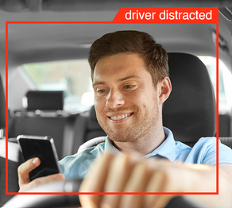
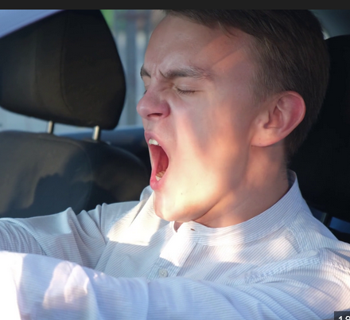
External Environment to Internal State
  Behavioral States Affecting Drivers Internal Capacity:
Distraction: Attentional diversion toward competing non-driving tasks that affects driving safety ^{[1]}
Drowsiness: State of Increased sleep propensity due to inadequate rest, circadian factors, or task-induced fatigue compromising driving safety ^{[2]}
DDD Precursors: An Observable systematic behavioral/physiological temporal patterns that consistently precedes and signals the increased likelihood of Distracted /Drowsy state
Higher
Objective Driver
Capability
Task Demand/
Driver Capability
Actual margin
of adaptation
Precursors can signal early failure in driver-environment adaptation
mechanisms
Objective Task
Demand
Lower
Multimodal Naturalistic Driving Databases for Distraction and Drowsiness:
[1] Regan et al.,2024
[2] Van Schagen.,2021
Notes:
We demonstrated how a capable driver continuously adapts to the road environment. However, this adaptation mechanism relies on the driver's cognitive and physical availability.
We now focus on the 'Internal State'—specifically, identifying the precursors related to distraction and drowsiness that degrade this availability and cause the adaptation loop to fail
Based on literature review, the most apt definition I find for distraction:as a diversion of attention created by and external event toward a competing non-driving task—be it visual or cognitive—that actively subtracts resources from the safety adaptation process we just discussed."*
Similarly drowsiness is characterized as a state of increased sleep propensity and a progressive degradation of capability caused by fatigue or circadian factors
My research focusses on and observable repeated temporal patterns of these behavioral/physiological states which signals the increased likelihood of entering these states
Hence it can signal as an early warning that the driver's ability to adaptation capacity is reducing.
When these signals appear, the 'optimal behaviors' identified in the previous slides by my collegues become less possible and action needs to be taken by the driver
To analyse these States and precurors I focus on Multimodal naturalistic driving databases
Such as I-Dreams, U-Drive, I described before

Slide 8
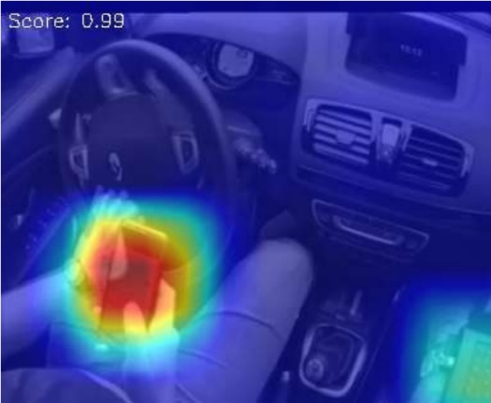

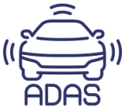

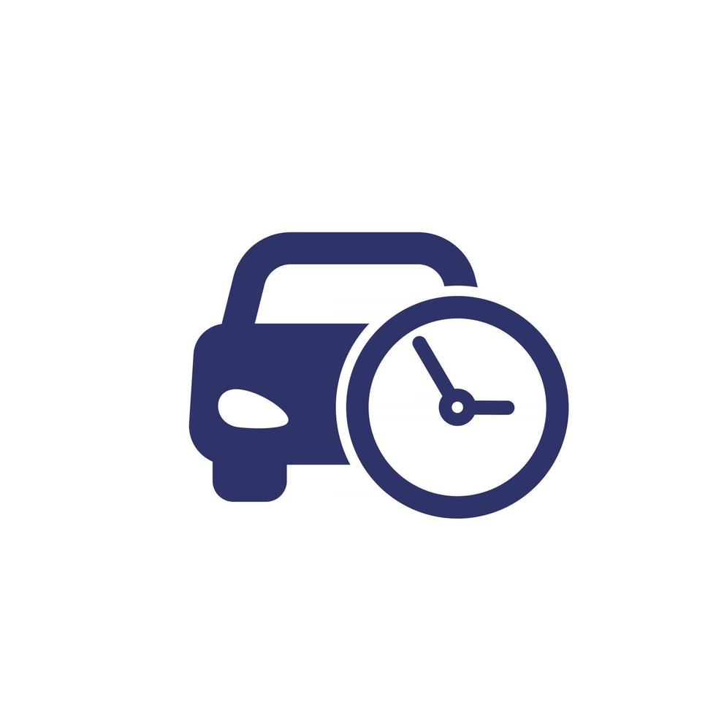

Distraction Indicators & Risk Correlation
  How visual distraction indicators (Phone/Gaze) lead to specific kinematic patterns
CNN-based Object Detection extracts phone or other object usage
Facemesh algorithm quantifies gaze dispersion zones and "Off-Road" glance duration metrics
Analysis of Gaze direction sequences with SCE ^{[4]} metrics and kinematics data
  Off-road glances VS TTC,THW
  Off-road glances preceding harsh braking or harsh acceleration events.
  Off-road glances >3.5 secs for speed>50km/hr ^{[5]}
  Repeated "Off-Road" glance patterns followed by SCE events
Distracted drivers have degraded adaptation capacity
[4] Safety critical events
[5] EU ADDW regulation
Notes:
Now looking at some of the methods I am currently working on in the distraction space
**Point 1:** “To focus on external distractions , I utilize Convolutional Neural Networks to detect physical distractors like mobile phones and other objects in the drivers seating area. This gives us a binary indicator of 'Manual Distraction,' identifying exactly when the driver physically disengages from the control loop." *
**Point 2:** “Along with this detection I use a customized Facemesh to track the gaze patterns and head pose. The idea is to track the zones in the driver's visual field on which the drivers focus deviates during the driving activity due to external distractions , this allows to calculate for eg 'Off-Road Glances’—a metric defining exactly how many milliseconds the driver’s eyes were off the safety-critical zone." I am also looking in the future to use eye-tracking technology with the LAB.Eg
* **Point 3:** “Finally I link this to the to kinematic behavior of the driver , to quantify these distracted epochs with respect to driver's 'Time Headway’, ‘TTC’ describing their—their safety buffer— and measure its fluctuations when compared to the driver baseline can be identified as reduction in optimal adaptation strategy." *
**Point 4:** "Crucially, I hope to observe a strong temporal link: between off-road glances exceeding a threshold range (based on data) that immediately appear before harsh braking, acceleration events, and/or other specific SCE events, indicating a failure to anticipate." * eg the EU ADDW regulation already mentions monitoring of of road glances based on speed which can be verified as well with real data.
**Point 5:** "From a Safety-II perspective, this is can be seen as reduced state adaptation capacity.

Slide 9
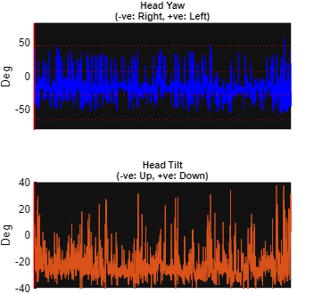
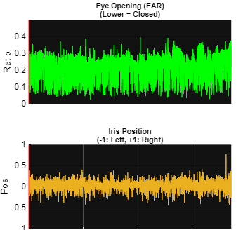
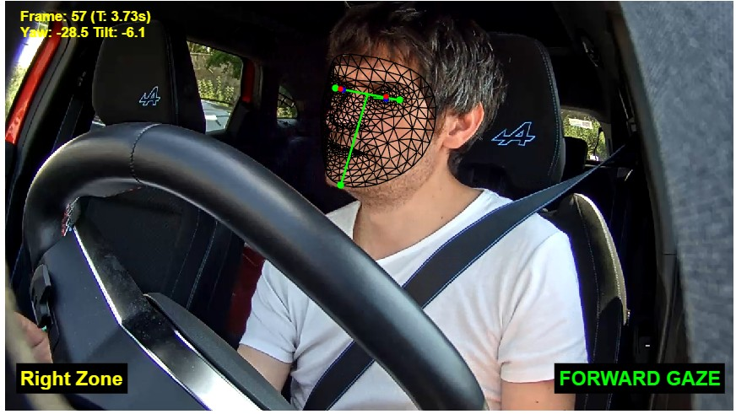
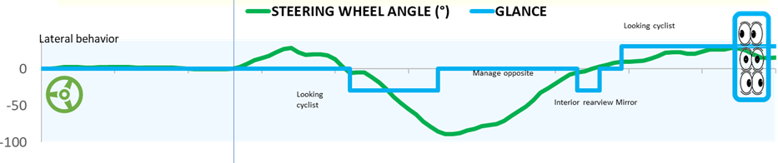
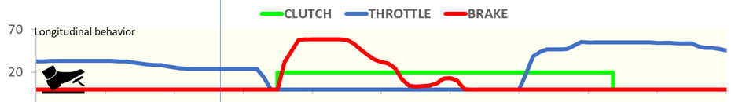
Facemesh Distraction Behavior Analysis
Facemesh 3D Landmark Regression for high-fidelity facial geometry
Deterministic geometric algebra to derive multivariate gaze time-series
Quantifying pre-event gaze latency during distraction to contextualize risky driving behaviors.
Notes:
A bit more detail on the working of the Facemesh gaze detection
POINT1:
The Model relies on a lightweight Convolutional Neural Network (CNN) architecture optimized for mobile edge inference. It employs an attention-based mesh freamework that regresses 478 distinct 3D points from a single RGB frame camera. It can be syncronised with multiple camears
This model is light weight and provides millimeter precision required to track the iris and eyelid contours even under partial occlusion from the steering wheel or hands.
POINT2:
The algorithm processes the raw CNN output facial points
Using 3-D Vector geometry is used to we calculate the normal vector of the face via the cross-product of the eye-line and chin-line vectors.
I also use a Normalized Vertical Iris Offset (NVO) metric , which basically tracks **Iris Center** wrt to the eye iner and outer conners. This helps to to distinguish true 'down-gaze’
from simple head-nodding
POINT3:
The final step is to merge and synchronise these glance signals with the phone usage video data
Then by correlating our gaze signals with vehicle indicators like harsh braking or lateral lane deviation, the idea is to quantify the latency between a visual distraction (e.g., looking at a phone) and the subsequent erratic steering maneuver and other SCE events
This helps us define the 'Safe Gaze Buffer'—the maximum allowable off-road glance duration based on the context for eg before a Safety Critical Event (SCE)

Slide 10
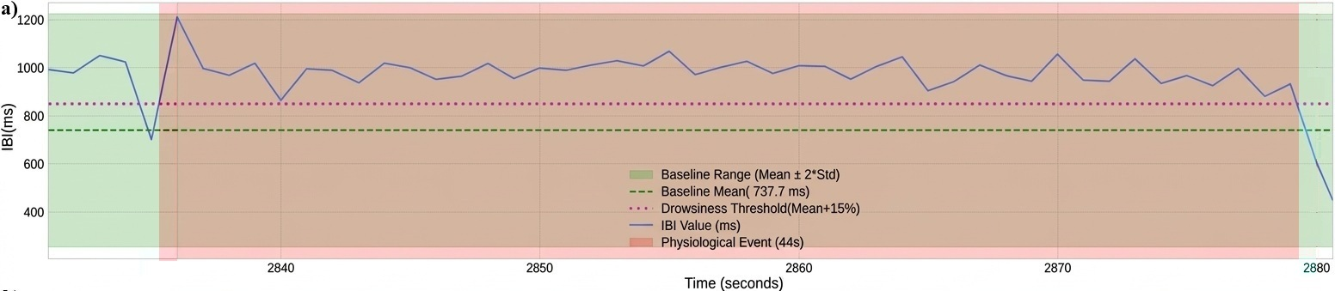
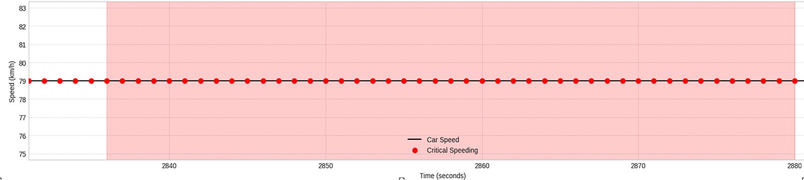
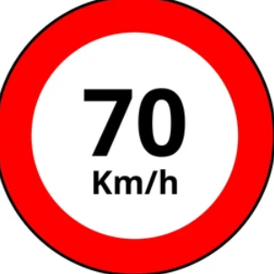
Physiological Drowsy Driving Analysis
Cardio metrics(e.g. Inter beat Interval) serve as physiological ground truth for autonomic regulation:
  Literature based drowsiness thresholds(IBI>15%) from drive baseline IBI range
  CV filter applied to ensure high signal quality (SNR ratio<20%)
  59 Drowsiness episodes found in 3260 hrs of driving
Physiologically defined drowsiness event ^{[6][7]}
Critical over-speeding during event
Drowsy driving episodes contained risky driving behaviors :
  Over-speeding events
  Harsh Acceleration
  Harsh Breaking
Constant over-speeding (79Km/hr) during event
[6]: Shaffer, F., & Ginsberg, J. P. (2017). An Overview of Heart Rate Variability Metrics and Norms. Frontiers in Public Health, 5, 258. https://doi.org/10.3389/fpubh.2017.00258
[7]: Jo, S.-H., Kim, J.-M., & Kim, D. K. (2019). Heart Rate Change While Drowsy Driving. Journal of Korean Medical Science, 34(8), e56. https://doi.org/10.3346/jkms.2019.34.e56
Notes:
**Point 1:** "Moving to the physiological Data in Idreams, we use Inter-Beat Interval (IBI) .These are not just medical stats; they are direct indicators of the Autonomic Nervous System's regulation, acting as our ground truth for 'Internal State’.”
The concept was to analyse the large i-dreams dataset based on literature based IBI drowsiness thresholds which indicate 10-15% increase in IBI from driver baseline is a sign of drowsines, and in this case a 15% conservative baseline was considered to be sure
Again to be more strict a temporal consistency filter of minimum 30 seconds, to ensure drowsiness
was considered with a minimum 5 min warmup and subsequent 10 min driving to establish a baseline
Also there was accounting for signal quality using CV filter (coffeient of variation) of less than 20% was used, which is standard for ECG measurements calculated based on the SD of the signal used for most industrial applications
So out of more than 3260 hours of driving only around 59 episodes were obtained ranging from 30 to 466s with around 15 drivers
These drowsiness episodes contained risky driving behaviors such as over speeding events, Harsh accelerations, Harsh Breaking etc
Here is an example of one such event during the episode

Slide 11
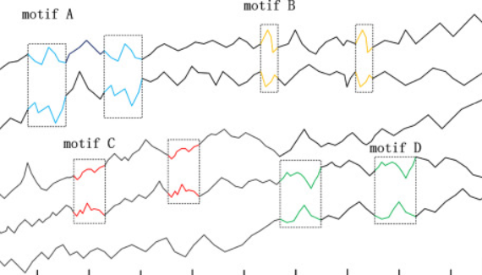
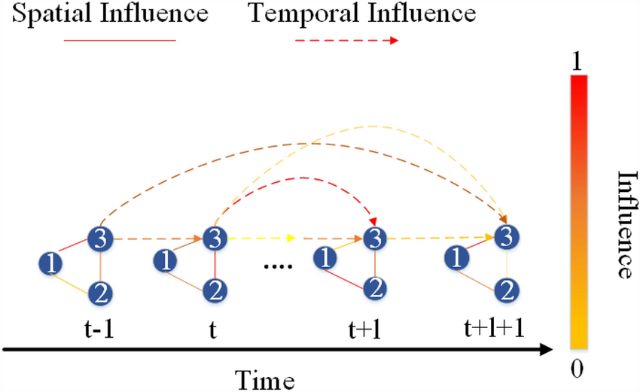



Future Steps: AI/ML models to Quantify Impact
Multivariate Time Series Analysis can fuse behavioral precursors with vehicular kinematics
Motif Discovery identifies recurring 'Shapelets' of driving behavior associated with distracted and drowsy states
Off road Gaze
Speed
Harsh Breaking
Time Headway
Graph Neural Networks (GNNs) can model spatial and temporal influence between these state risks and enhance driver adaptation .
TTC
Off Road Glances
Phone use
Time Headway
Notes:
POINT 1:Finally to find strong correlations between the driver adaptation behavior degradations and driver states of distraction and drowsiness we plan to employ
Multivariate Time Series Analysis. We are not looking at static points, but at the dynamic fusion of behavioral signals (Gaze/HRV) and kinematic outputs (Speed/Steering) over time
POINT 2: We can also use Motif Discovery to find 'Shapelets'—recurring geometric patterns in the driving data. For example, we could identify a specific 'micro-swerving' motif that appears almost exclusively during early-stage drowsiness. And compare it with the driver sewring motif during aleart states
POINT3: Another promising model is STGNNs Graph neural networks where Driver State and Vehicle Dynamics act as connected nodes and it helps to qualtify
The influence of each node on the other in a probabilitistc manner . This could be a way to quantify the impact of distraction and drowsiness behaviors on driver adaptive manouvers
When you compare these same manouvers during an alert or non distracted state

Slide 12
IVORY Conference Athens
Thanks for your attention

Slide 13
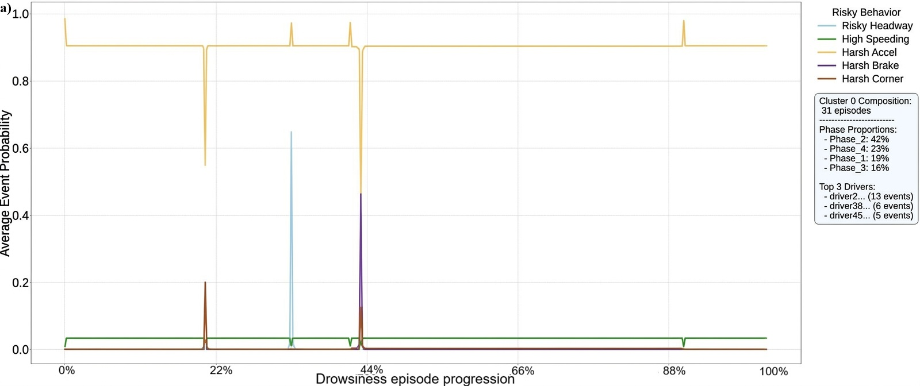
Physiological Drowsy Driving Analysis
Dynamic Time Warp (DTW) clustering applied to risky driving variables during drowsy events:
  Harsh (Acceleration, Breaking, Cornering),
  Risky Headway (<0.7sec)
  High speeding (5% above speed limit)
Drowsiness episodes VS Risky driving behaviors :
  Drowsy driving behavior is an evolutive state
  Composite drowsy driver behavior across episode
Erratic Acceleration
Sharp braking
Notes:
POINT1
A further temporal clustering with DTW algorithm was applied on risky driving variables found during these drowsiness events
Point 2 :
The DTW algorithm shows firstly drowsy driving is an evolutive state across time.
The DTW algorithm aligns and clusters temporal similarities between multiple drivers for these behaviors . To generate a time cetroid showing the composite
behavior or drivers during the episode. It shows the central tendency—the most representative pattern—for all the episodes in that group
From the behavior pattern in the centroid we can see that the driver behavior is punctuated with erratic acceleration counts and sudden spikes of Harsh breaking
Indicating that the drivers generally misjudge the distance with the leading vehicle , another sign of reduced adaptation capacity

Slide 14
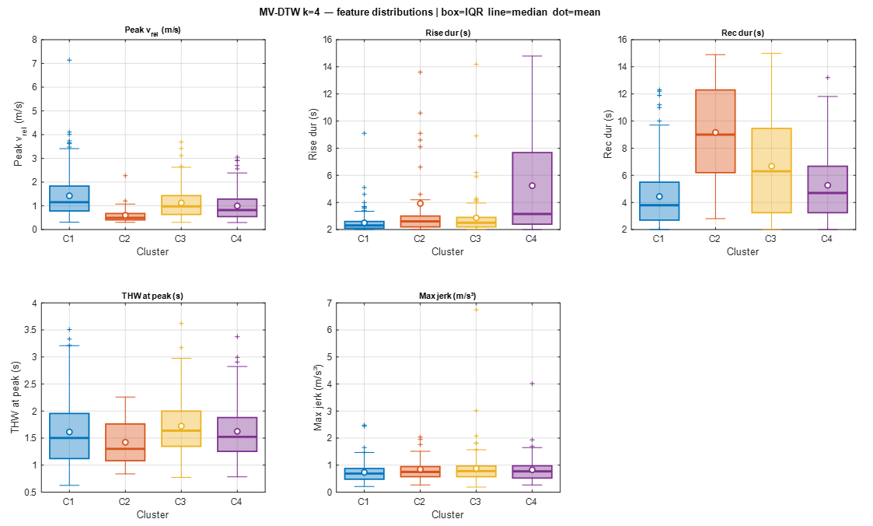
Behaviour Adaptation
Notes:
How can we identify successful and degraded adaptation in naturalistic driving?
Core message:
DC6 aims to detect, characterize, and compare patterns of driver adaptation across the behavioural spectrum. Rather than isolated time points, adaptation should be studied as a temporal process.

