Slide 1
Work Package 5 : Road User Assistance
IVORY Mid-term Conference
Athens, 15 April 2026

Slide 2
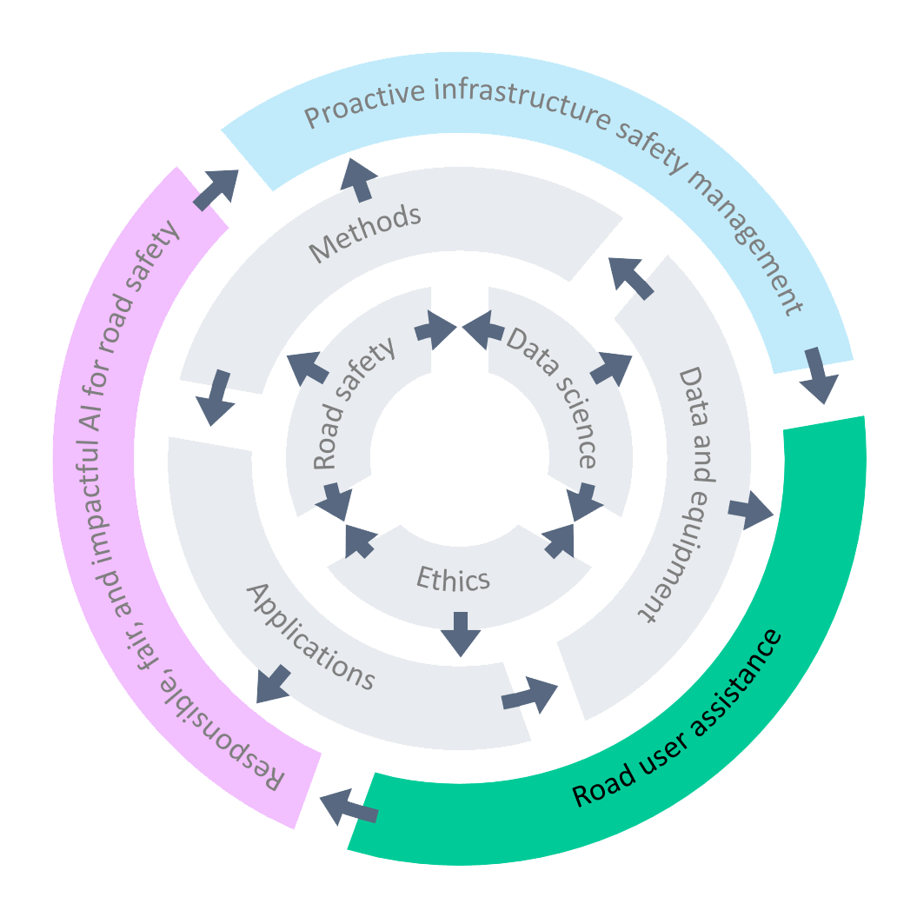
IVORY WP5 – Overarching goals
Advance road user profiling and coaching tools using naturalistic driving data (DC4, 7)
Study the impact of key human factors such as driver distraction and drowsiness at higher SAE (Society of Automotive Engineers) levels of automation (DC 5, 14)
Develop new ways of supporting road users and human-vehicle-environment interaction by means of AI (DC6)

Slide 3
Session overview
Presentation 1: From Raw Signals to Road Safety: Feature Engineering for Driver–Vehicle–Environment Interaction
All DCs
Presentation 2: Adaptive Driver Behaviour and Driver State Monitoring in Naturalistic Driving
Ajay Iyer (DC5) & Mohammad Pashaee (DC6)
Presentation 3: Sleepiness on the Road: Integrating Physiological, Behavioural, and Vehicle-Based Indicators
Aristotelis Styanidis (DC14) & Ajay IYER (DC5)
Presentation 4: From Prediction to Intervention: Personalised Driver Profiling and AI-Enabled Driver Assistance
Shi Qiu (DC4) & Aristotelis Tsoutsanis (DC7)

Slide 4
From Raw Signals to Road Safety: Feature Engineering for Driver–Vehicle–Environment Interaction
WP5: Road User Assistance
IVORY Mid-term Conference
Athens, 15 April 2026

Slide 5
DC4: Research project
Road user profiling using multimodal data of naturalistic driving databases
Final purpose: Transfer drivers' multimodal driving data to personalized feedback and coaching strategies for improving their driving safety.

Slide 6
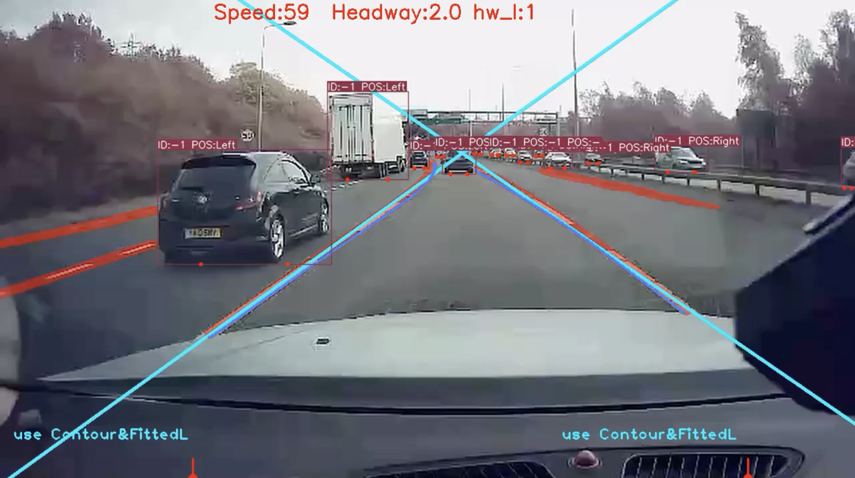
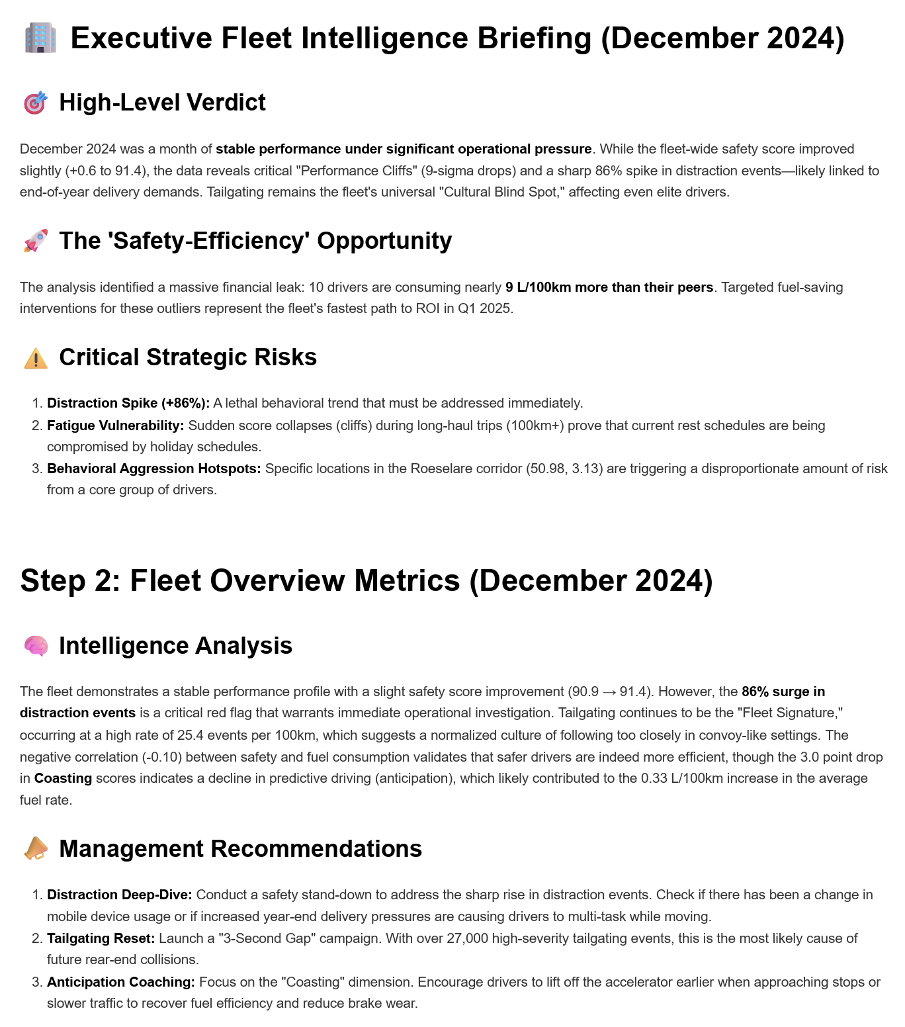
DC4: Data & Feature
Multimodal Trip data: dashcam videos, telematics (speed, GPS, headway), risky events, fuel consumption, calculated safety and eco-driving scores.
Feature Engineering:
Multi-modal preprocessing: Data synchronization, data enrichment
CV: Object detection & tracking, lane marking detection, event detection
NLP: LLM-based data processing and analysis, driving behavior understanding, feedback and text report generation

Slide 7




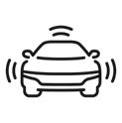




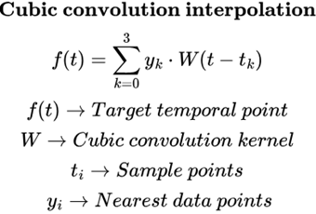
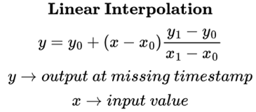
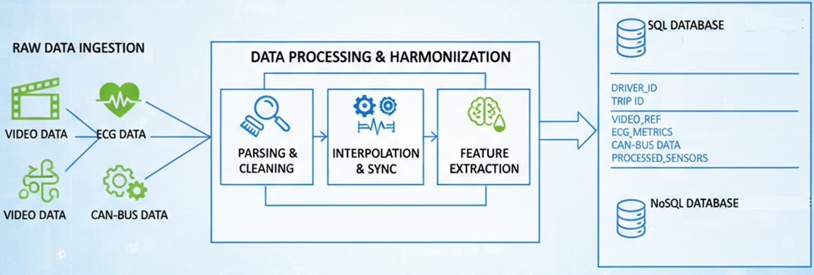
DC5: Big Data Heterogeneity
Managing large naturalistic driving data with video and physiological information.
Structuring big data across driver, trip, and environmental contextual levels
Bridging heterogeneous sampling rates across distinct multimodal sensor data streams
Mitigating missing data and sensor dropouts using imputation techniques
Scaling preprocessing pipelines for continuous multi-sensor environments
Notes:
•**Point 1:** “One foundational challenge in my case is managing the volume and heteroginetity of Naturalistic driving databases such as UDRIVE and i-DREAMS. We are ingesting large amounts of continuous, unconstrained naturalistic data, which requires a robust pipeline infrastructure just to load, parse, and synchronize the raw files." *
•**Point 2:** "To make sense of this heterogeneity, it is best to structure the data hierarchically so preprocessing pipelines can injest data easily . We isolate variables at the macro-level (environmental context and trip characteristics) down to the micro-level (individual driver baseline and vehicle level traits) to ensure analytical consistency." *
•**Point 3:** "Another challenge is temporal alignment, which required bridge variables recorded at entirely different sampling rates—like 30Hz video against 10Hz CAN-bus data—using mathematical interpolation techniques to project them onto a unified, synchronized temporal grid.“ eg linear interpolation that calulates exact kinematic value $y$ at a specific video frame $x$ *
•**Point 4:** "Naturalistic data is inherently noisy and prone to sensor dropouts, such as a driver shifting off-camera or an ECG band losing contact. For such non linear signals Certain imputation strategies , like cubic convolutional interpolation, can be used to mathematically reconstruct these missing windows that preserves the non-linear nature of the data*
•
•**Point 5:** “Finally once , preprocessing steps provide a robust ouput we try and engineer it to scalable pipelines. This ensures that all types of driver data (10-minute commute or a 4-hour highway trip), the data feeding into our AI models is temporally aligned and structurally uniform."
Explainations:
àA cubic spline $S(t)$ interpolates the missing gap by creating piecewise cubic polynomials between valid IBI data points (knots).Since The formula solves for a polynomial curve that perfectly matches the 'momentum' (first and second derivatives) of the heart rate leading into the gap.

Slide 8
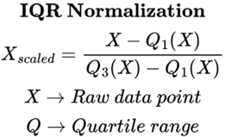
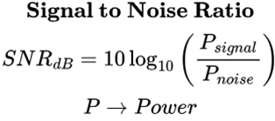
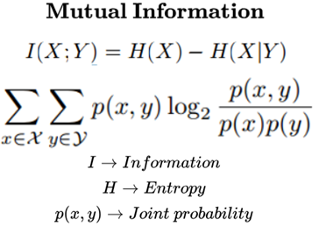
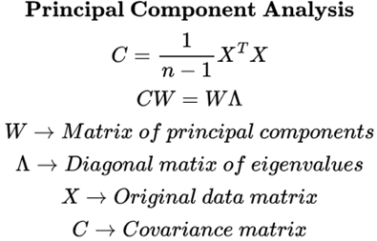
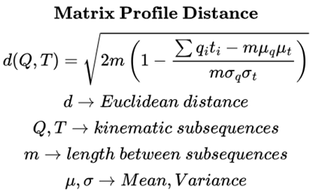
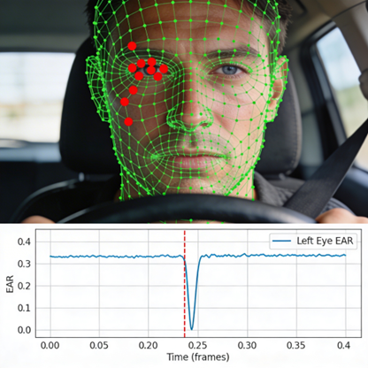
DC5: Feature Transformation & Signal Processing
Normalizing variables via Z-score, log transformations, and IQR-based methods
Applying SNR algorithm thresholds to enforce cardiovascular signal quality data.
Optimizing feature selection using Mutual Information and Principal Component Analysis.
Driving kinematic behavioural features using Matrix Profile motif discovery algorithms.
Transforming raw video facial landmarks into continuousocular and facial signals(EAR,MAR)
Notes:
*Focus:, Cleaning the data, extracting specific metrics (EAR, Motifs), and reducing dimensions and normalizing data*
•**Point 1:** "Given the diverse distributions of features between physiological data(egPERCLOS,EAR,MAR etc) and kinematic data(Steering angle,yaw rate) different feature transformations and normalizations are required. We dynamically apply Z-scores for normally distributed data, log transformations for heavily skewed reaction times, and Interquartile Range (IQR) scaling to protect kinematic data from extreme outliers." *
•**Point 2:** "Because naturalistic driving creates immense motion artifacts and noise in the data for eg, extracting IBI or HRV data from driver heart beats .Signal-to-Noise Ratio (SNR) algorithms was applied to enforce quality thresholds, discarding corrupted windows entirely." *
•**Point 3:** "Finally, to overcome the curse of dimensionality generated by these three modalities, we deploy Mutual Information to filter out irrelevant variables, and PCA to compress collinear features(eg Steering wheel angle and Gyroscopre variables more collieanly), ensuring our models remain efficient and focused.“
•**Point 4:** "For vehicular kinematics, we are exploring Matrix Profile algorithms. Rather than using basic averages, this allows us to discover 'Motifs'—recurring, statistically significant shapes in the steering or speed data that represent specific driver behaviors." * Matrix Profile algorithm is generates new time-series, called a 'Distance Profile a value representing how mathematically similar that specific 5-second subsequence is to its nearest neighbor anywhere else in the same signal
•
•**Point 5:** "On the visual front, we don't feed raw pixels into our predictive models. We transform the complex 3D FaceMesh coordinates into continuous, physics-based 1D signals—like the Eye and Mouth Aspect Ratios—drastically reducing noise and computational load." *
Explainations::
àSNR in the time domain by relying on the statistical dispersion of the signal, utilizing metrics like localized variance and the Coefficient of Variation ($CV = \frac{\sigma}{\mu}
We apply a rolling **Median Filter** to the raw IBI data
*$P_{signal}$** is simply calculated as the variance of this smoothed
$P_{noise}$** is calculated as the variance of the *residuals*(the mathematical difference between the raw IBI sequence and the smoothed median line).
àUsed before PCA
$X$ is an engineered feature (e.g., standard deviation of lane position) and $Y$ is the ground-truth driver state (e.g., Drowsy vs.
•**$H(X)$** represents the total uncertainty or 'information content' of the feature itself. * **$H(X|Y)$** represents the uncertainty that remains in that feature *after* we already know the driver's state.
•Mutual Information $I(X;Y)$ calculates exactly how much our uncertainty about the driver's state is *reduced* by observing that specific feature
•Eg cabin temperature yeilds no 0 I(X;Y) no information then we reject that feature
•
•
•

Slide 9
Introduction to Telematics for Driver Behaviour
From raw sensor data to actionable risk insights
1
2
3
4
Sensor Data
Collection
Event
Detection
Contextual
Enrichment
Risk
Profiling
Accelerometers, gyroscopes & GPS capture motion patterns via smartphone or OBD-II
Algorithms identify harsh braking, rapid acceleration & aggressive cornering events
Road infrastructure & environmental data integrated to contextualise driving behaviour
Aggregated event scores produce a holistic driver risk profile

Slide 10
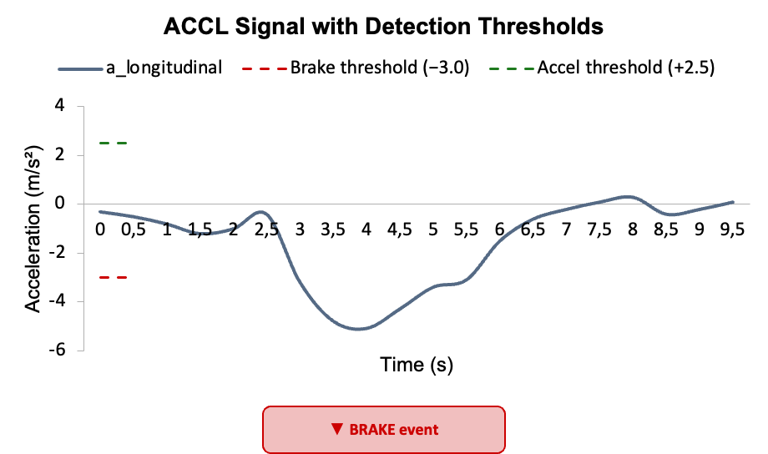
Telematics for Driver Behaviour
High-frequency 3-axis accelerometer and gyroscope data captured via Smartphone IMU or OBD-II
Filtering noise, removing gravity, and virtually realigning axes
Integrate context related data such as Infrastructure (OpenStreetMap)
GPS corroboration
interpolate GPS-derived acceleration at peak time
Contextual Risk Scoring: Aggregating discrete events (braking, cornering, accelerating) to profile driver anticipation and reaction times.

Slide 11
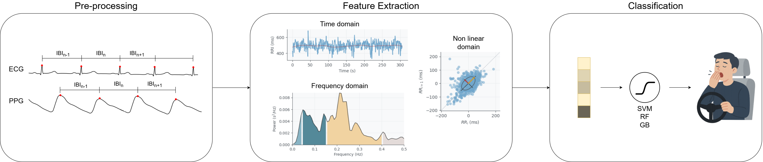
Feature Engineering with Physiological Signals
Data preprocessing:
Remove noise and artifacts (e.g., filtering, normalization)
Handle missing or corrupted signal segments (signal quality assessment)
Synchronize multiple physiological signals
Sliding Windowing:
Segment continuous signals into fixed-length windows
Enable real-time or near real-time analysis
Allow temporal tracking of physiological changes

Slide 12
Feature Engineering with Physiological Signals
Feature Extraction:
Compute relevant features (time-domain, frequency-domain, non linear-domain)
Capture patterns related to drowsiness (e.g., variability, power bands)
Reduce raw signal complexity into meaningful representations
Classification:
Apply machine or deep learning model to classify alert vs drowsy states
Train using labeled data and validate performance
Output final prediction for each window or time segment

Slide 13
Thank you!

Slide 14
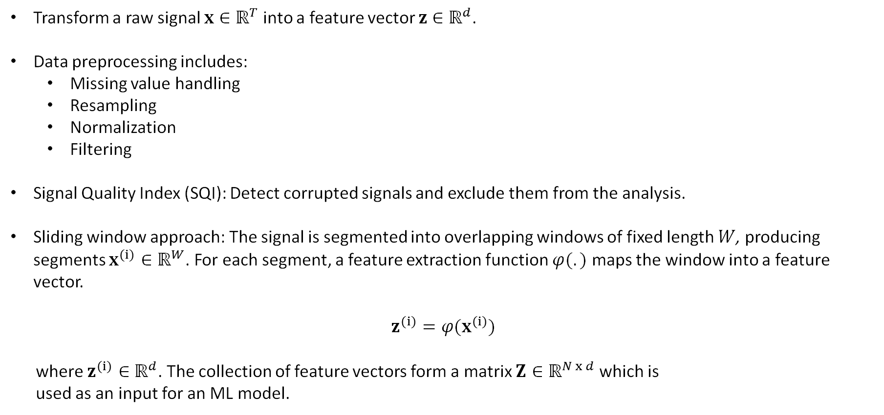
Feature Engineering with Physiological Signals
Transform a raw signal $x∈ℝ^{T}$ into a feature vector $z∈ℝ^{d}$.
Data preprocessing includes:
Missing value handling
Resampling
Normalization
Filtering
Signal Quality Index (SQI): Detect corrupted signals and exclude them from the analysis.
Sliding window approach: The signal is segmented into overlapping windows of fixed length $W$, producing segments $x^{(i)}∈ℝ^{W}$. For each segment, a feature extraction function $φ(.)$ maps the window into a feature vector.
$$z^{(i)}=φ(x^{(i)})$$
where $z^{(i)}∈ℝ^{d}$. The collection of feature vectors form a matrix $Z∈ℝ^{N x d}$ which is used as an input for an ML model.

Slide 15
Feature Engineering with Physiological Signals
Transform a raw signal x∈R^T into a feature vector z∈R^d.
Data preprocessing includes:
Missing value handling
Resampling
Normalization
Filtering
Signal Quality Index (SQI): Detect corrupted signals and exclude them from the analysis.
Sliding window approach: The signal is segmented into overlapping windows of fixed length W, producing segments x^((i))∈R^W. For each segment, a feature extraction function φ(.) maps the window into a feature vector.z^((i))=φ(x^((i)))
where z^((i))∈R^d. The collection of feature vectors form a matrix Z∈R^(N x d) which is used as an input for an ML model.

Slide 16
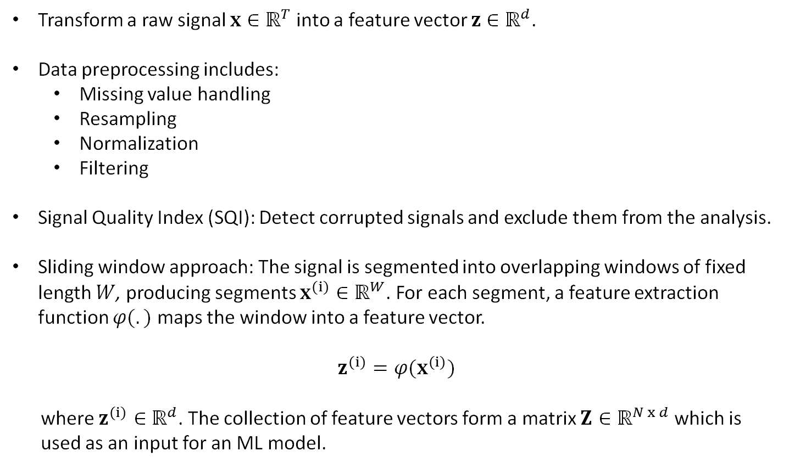
Feature Engineering with Physiological Signals
Transform a raw signal $x∈ℝ^{T}$ into a feature vector $z∈ℝ^{d}$.
Data preprocessing includes:
Missing value handling
Resampling
Normalization
Filtering
Signal Quality Index (SQI): Detect corrupted signals and exclude them from the analysis.
Sliding window approach: The signal is segmented into overlapping windows of fixed length $W$, producing segments $x^{(i)}∈ℝ^{W}$. For each segment, a feature extraction function $φ(.)$ maps the window into a feature vector.
$$z^{(i)}=φ(x^{(i)})$$
where $z^{(i)}∈ℝ^{d}$. The collection of feature vectors form a matrix $Z∈ℝ^{N x d}$ which is used as an input for an ML model.
Pre-processing
Feature Extraction
Feature Selection
Classification
Prediction
Notes:
This one will go to the other session most probably… along with an image

