Slide 1
From Infrastructure to Behaviour: Learning Risk Patterns from Telematics
Paradiso, S., Porto, J.A., Ziakopoulos, A., Sideris, H., Avgeros, J., Forstakis, P., Yannis, G.
IVORY Mid-Term Conference – “AI for Vision Zero in Road Safety”
Athens, 15 April 2026

Slide 2
Presentation Overview
Introduction: telematics data as SMoS
Our lines of work
  Harsh-event from telematics data as a measurable safety output and its relationship with environment attributes
    Computer Vision
    Regression models
  Driving behavior from telematics data used as an input to understand hazardous patterns throughout the road network
    Graph Neural Network
    Clustering

Slide 3

Telematics Data as SMoS
Because of the restrictions of crash data, Surrogate Measures of Safety – SMoS have been increasingly used as a safety measure
As an SMoS, telematics data can give insights about road user behaviour by measuring harsh event frequency and intensity
Those events can be further associated with:
  Environment features
  Traffic conditions
  Weather
  Time

Slide 4
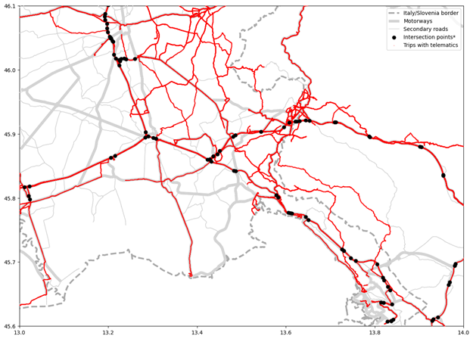
Harsh Events and Visual Environment Attributes
Goal:
  explore whether street view image attributes can be used to estimate risk level based on telematics data
Data:
  Motorway junctions close to Gorizia, Italy
  Telematics data: harsh events (braking and acceleration) from 322 trips between March/2021 and March/2025 from OSeven
  Imagery data: Mapillary and DeepLabV3+ segmentation with Cityscapes training
  Selection criteria: 50-m circular buffer and at least 2 trips
Methods:
  Spearman Correlation
  Count models: Poisson and Negative Binomial

Slide 5
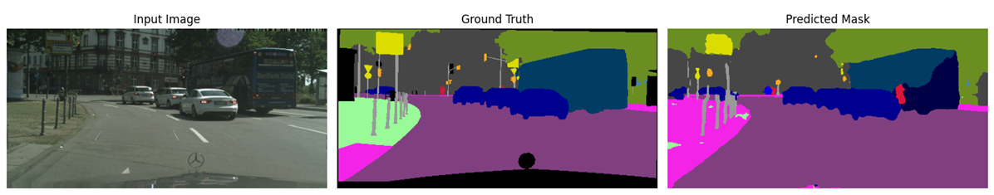
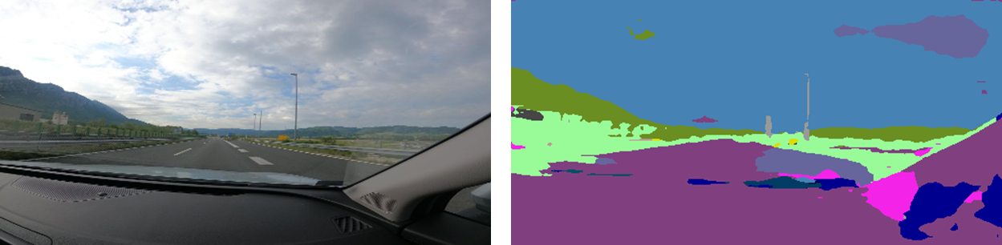
Visual Environment Attributes from Cityscapes
18 attributes: road, sidewalk, building, wall, fence, pole, traffic light, traffic sign, vegetation, terrain, sky, person, rider, car, truck, bus, train, motorcycle, bicycle

Slide 6
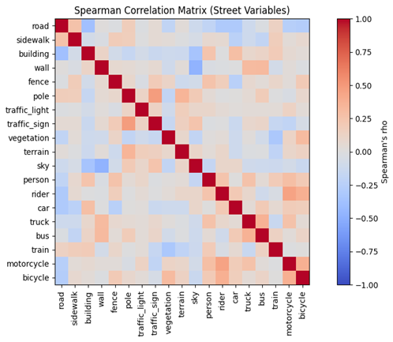
Correlation Results
Autocorrelation between some street variables:
  Wall and Sky: negative correlation
  Rider and motorcycle/bike: positive correlation
Only terrain presented significant correlation with number of harsh events
  ρ = -0.2339
  p-value = 0.0204

Slide 7
Regression Results
Poisson had a better fit than Negative Binomial
Including number of trips as a variable instead of an offset increased model prediction, as well as adding speed
Flat pixels consistently showed high statistical significance, suggesting that narrower roads and broad view distance improve behaviour generally
Road users, poles and signs might be better related with number count than pixel proportion
Model | Number trips as offset |  | Number of trips and speed as variables
Variables | β | p-value | β | p-value
Constant | -7.3278 | 0.000 | -1.8787 | 0.199
Construction | 0.3165 | 0.049 | 0.2894 | 0.168
Flat | -0.2593 | 0.000 | -0.1549 | 0.010
Poles and signs | -0.0598 | 0.475 | -0.1098 | 0.217
Nature | 0.6816 | 0.117 | 1.1323 | 0.027
Road users | -0.4889 | 0.005 | -0.2778 | 0.156
Number of Trips |  |  | 0.0222 | 0.000
Mean speed |  |  | -0.0294 | 0.003
Pseudo-R² | 0.3730 |  | 0.5431
AICc | 112.7693 |  | 105.0355

Slide 8
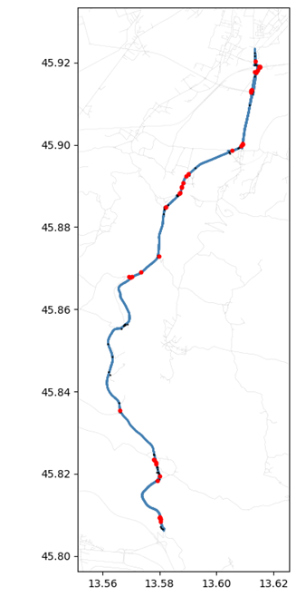
Current and Future Work
Using iRAP coded attributes for harsh event prediction
Using different models to obtain relevant road information from imagery data for a completely automated pipeline
Challenges: working with a dataset that is simultaneously imbalanced and small

Slide 9
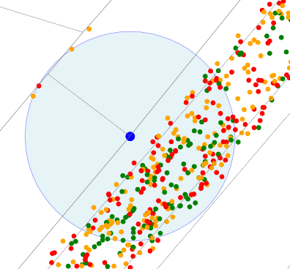
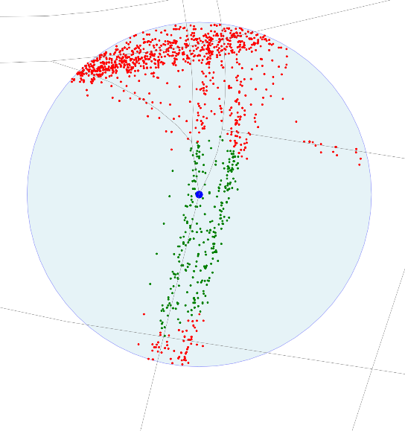
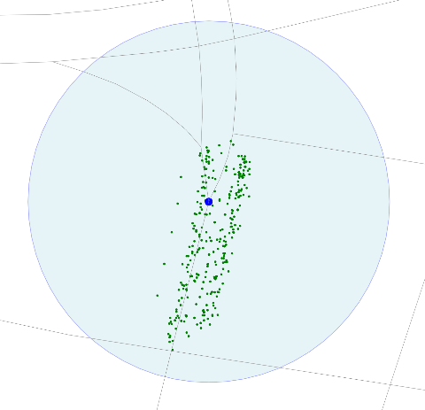
Telematics Data Integration with Road Network
Goal: Spatial analysis of driving behavior using per-second telematics.
Integration Approach:
  Edges: Assign each observation to the closest road segment, then aggregate (average, sum, etc.).
  Nodes:
    Basic: Use simple buffers around intersections.
    Improved: Only include observations on edges directly connected to the node within the buffer area.

Slide 10
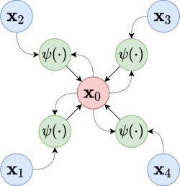
Introduction to Graph Neural Network
What are GNNs?
  Neural networks designed to work on graph-structured data (nodes + edges).
  Capture relationships and interactions between entities, not just independent features.
Why use GNNs?
  Standard neural networks (CNNs, MLPs) assume grid-like or independent data.
  GNNs model dependencies, making them ideal for social networks, traffic, telematics, and molecular data.
Key Idea
  Each node updates its representation by aggregating features from neighbors.
  Enables learning both local structure and global patterns.

Slide 11
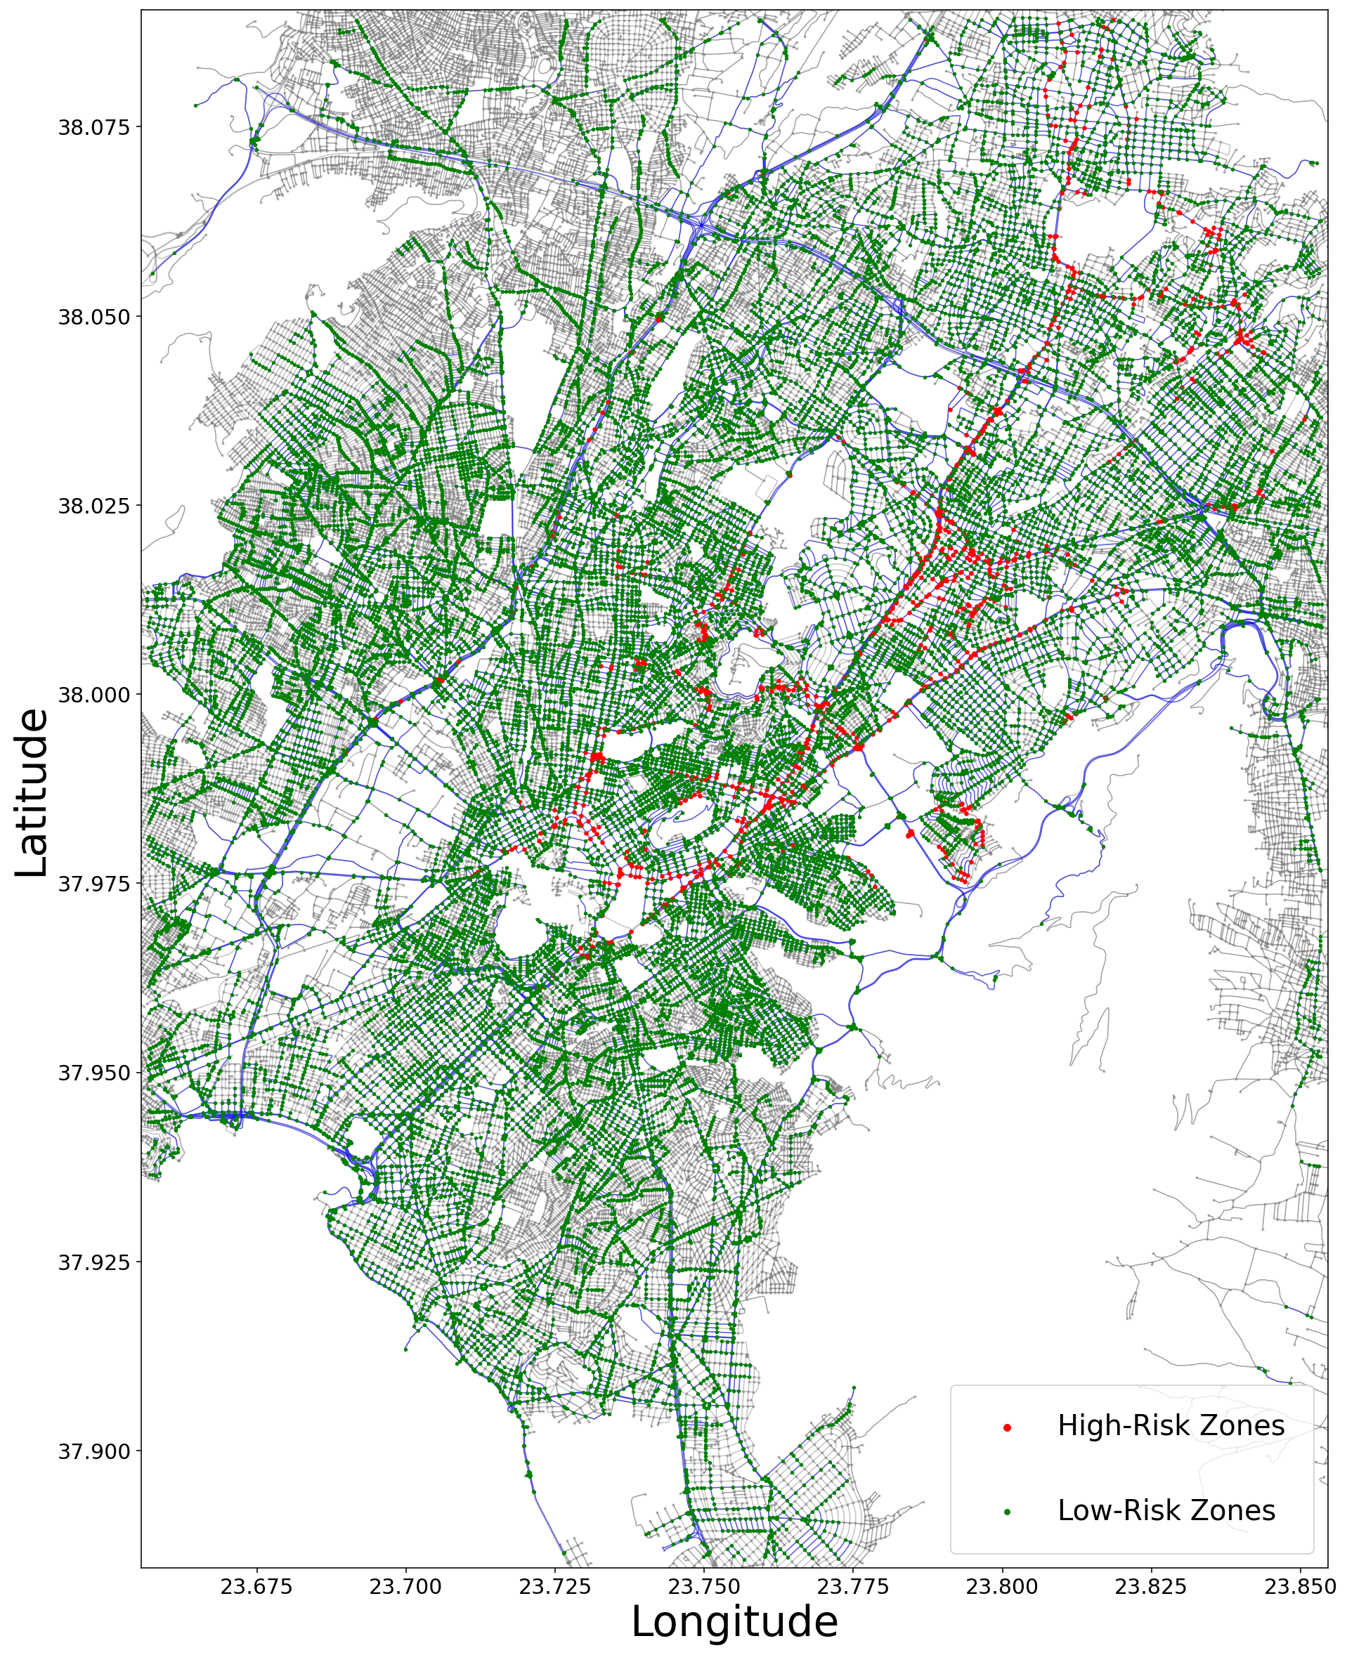
Graph Neural Networks Meet Cluster Analysis
GNNs on Road Networks
  Spatially aggregated telematics → node embeddings capturing network structure + driving behavior.
Node Embeddings → Clustering
  Learned node representations are fed into clustering algorithms.
Benefits:
  More reliable clustering vs raw features.
  Improved interpretability of driving patterns.
Driver Behavior Groups
  Calm zones: 🟢 nodes → smooth driving.
  Unsafe zones: 🔴 nodes → aggressive or careless driving.

Slide 12
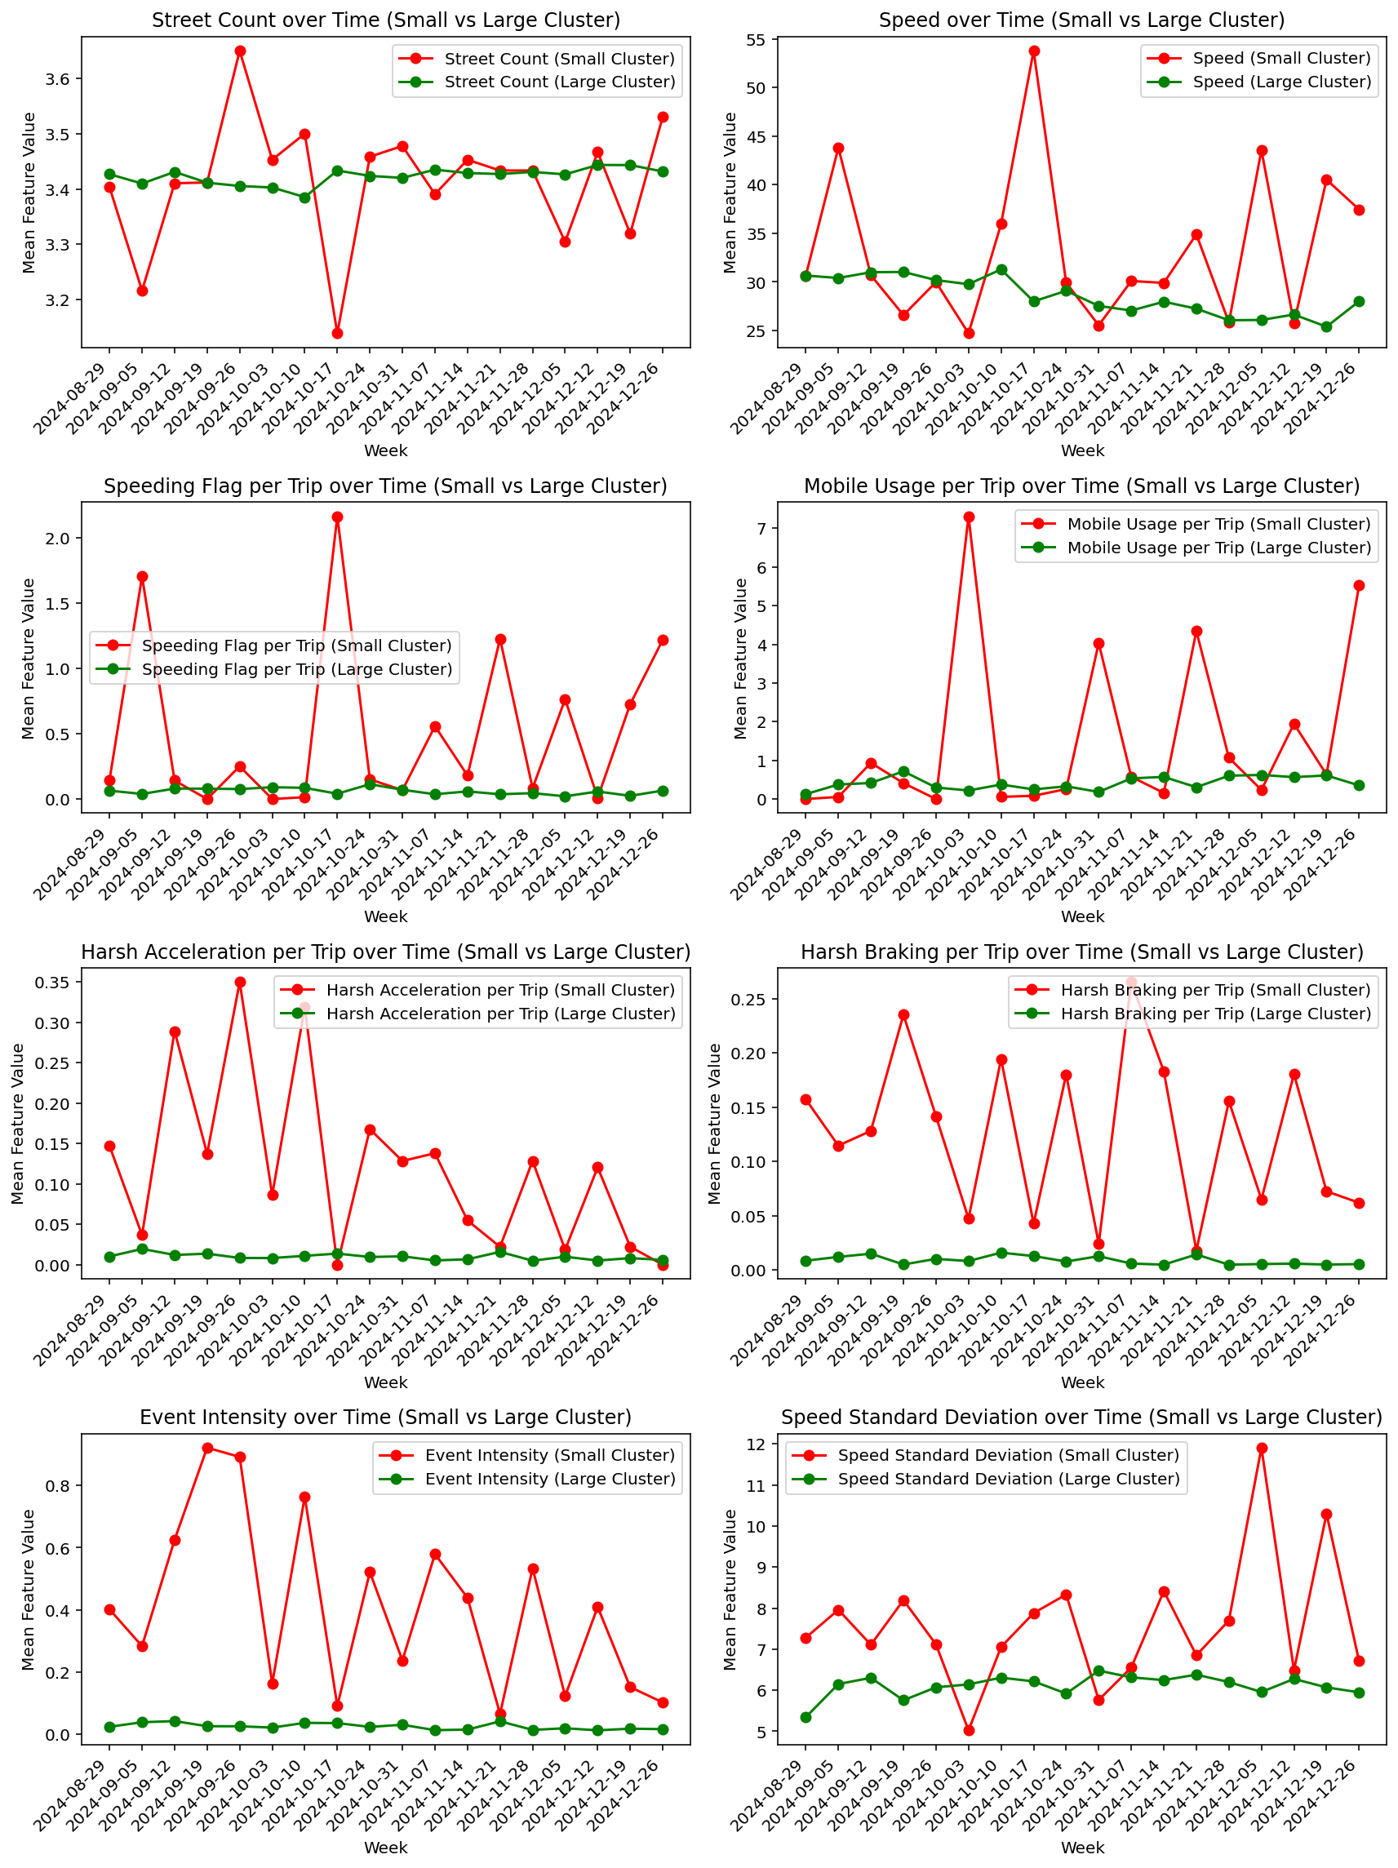
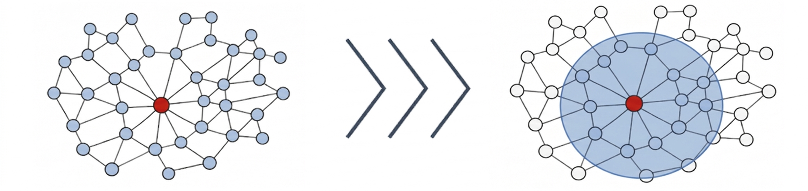
Graph Neural Networks Meet Cluster Analysis
Loss Function Tweak
  Encourage each node to be similar to itself under small perturbations (positive pair) and distinct from other sampled nodes (negative pairs).
  From global negative sampling → local negative sampling.
  Focuses on more meaningful node contrasts improving the clustering performance.
Temporal Dimension
  Weekly aggregation captures temporal patterns.

Slide 13
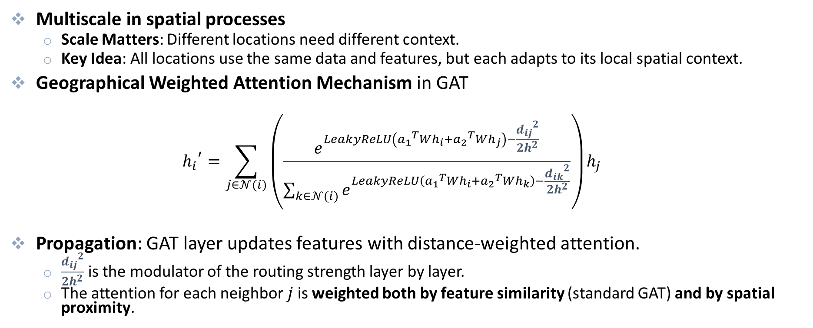
Towards a Multiscale Framework
Multiscale in spatial processes
  Scale Matters: Different locations need different context.
  Key Idea: All locations use the same data and features, but each adapts to its local spatial context.
Geographical Weighted Attention Mechanism in GAT
  $${h_{i}}^{′}=\sum_{j∈𝒩(i)}{\left(\frac{e^{LeakyReLU\left({a_{1}}^{T}Wh_{i}+{a_{2}}^{T}Wh_{j}\right)−\frac{{d_{ij}}^{2}}{2h^{2}}}}{\sum_{k∈𝒩(i)}{e^{LeakyReLU\left({a_{1}}^{T}Wh_{i}+{a_{2}}^{T}Wh_{k}\right)−\frac{{d_{ik}}^{2}}{2h^{2}}}}}\right)h_{j}}$$
Propagation: GAT layer updates features with distance-weighted attention.
  $\frac{{d_{ij}}^{2}}{2h^{2}}$ is the modulator of the routing strength layer by layer.
  The attention for each neighbor $j$ is weighted both by feature similarity (standard GAT) and by spatial proximity.

Slide 14
Key Findings and Future Directions
Network-Aware Driver Behavior Insights
  Node embeddings + clustering → better interpretability of driver behavior patterns.
Time Dimension
  Temporal patterns captured through aggregation over time.
Improved Clustering via Loss Function Tweaks
  Local negative sampling emphasizes meaningful contrasts, resulting in more robust and insightful clustering.
Future Work
  Extend the approach to a multiscale architecture that adapts to local spatial contexts, capturing complex dynamics more effectively.

Slide 15
Thank you!
Paradiso, S., Porto, J.A., Ziakopoulos, A., Sideris, H., Avgeros, J., Forstakis, P., Yannis, G.
National Technical University of Athens
Department of Transportation Planning and Engineering
&
OSeven Telematics

