Slide 1
Ensuring ethical AI in road safety: From theory to practice
Amir Pooyan Afghari, Bahareh Khajehpour, Amirhossein Hassani
15 April 2026, Athens

Slide 2



AI Ethics in Road Safety
Ethical dimensions
What is ethics?
Why is it important?
What are the different ethical aspects of AI
in road safety?
Methods
Applications
How to translate the ethical dimensions from theory to practice?
What are the real-world ethical implications in road safety problems? A case of LMIC
Notes:
© Copyright PresentationGO.com – The free PowerPoint template library

Slide 3
Technology & Ethics
What is engineering for?
Is it only a technical expertise deployable for whoever needs it and has the money to pay for?
or
Should it be in service of public welfare?
Codes of Ethics
Engineers, in the fulfillment of their professional duties, shall hold paramount the safety, health, and welfare of the public.
Notes:
Only an instrument for states and companies
A technical employee
With ethics as a personal rather than a broad professional concerns
Or it is beyond a profession and is a mission
And engineers precisely because of their technical knowledge have a responsibility to the society
carries a social obligation - obligations of engineers to society, to their clients, and to the profession
Especially with their ever-increasing role in management, consultancy
not in service of profit of states (for colonial expansion) or companies
A choice between being practical or being socially engaged
Expose engineers to broader intellectual questions
---
First codes of ethics in engineering were for technical reliability
The engineers recognize that the greatest merit is the work and exercise their profession committed to serving society, attending to the welfare and progress of the majority. By transforming nature for the benefit of mankind, engineers must increase their awareness of the world as the abode of humanity, their interest in the universe as a guarantee of overcoming their spirit, and knowledge of reality to make the world fairer and happier. The engineer should reject any paper that is intended to harm the general interest, thus avoiding a situation that might be hazardous or threatening to the environment, life, health, or other rights of human beings.

Slide 4
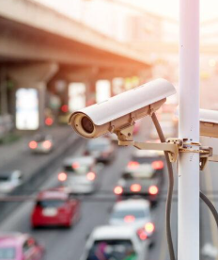
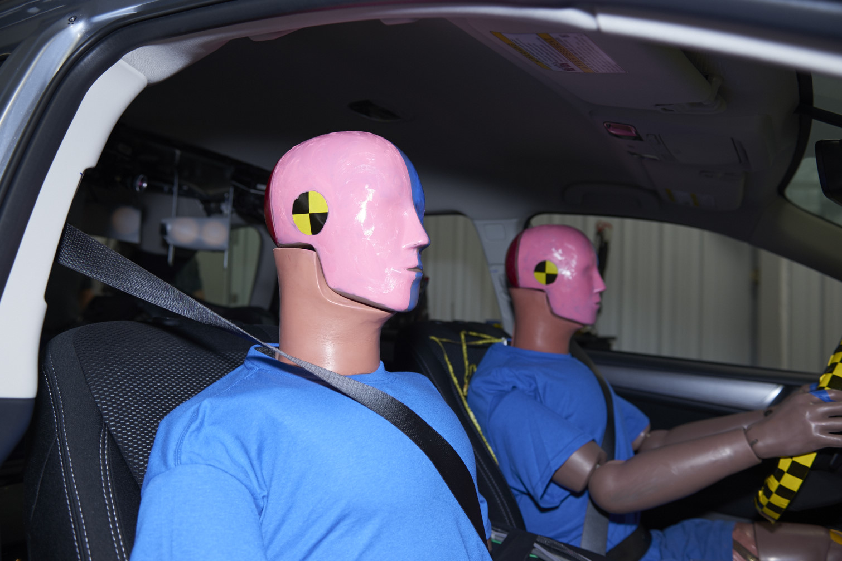
Safety Technologies & Ethics
What can ethics say about technologies that are essentially aimed at improving safety?
Guide the advancement of technology to be based on societally shared values
Protect against the misuse of technology
Particularly, safety as the ultimate goal may
Delay critical reflection
Allow easier justifications
Notes:
engineers shall, in all matters related to their profession, treat all persons fairly regardless of gender, ..
simple technical mis-calculations, failure of the design process
But also vulnerability to hostile intent regardless of project specifications
Technology ethics is the application of ethical thinking to growing concerns as new technologies continue to rise in prominence.
discovering the ethical uses for technology, protecting against the misuse of technology,^{[2][3]} and devising common principles to guide new advances in technological development and application to benefit society.
as technology advances in areas unseen by creators and as users change the intended uses of new technologies
While provide opportunitities, they bring about new ethical challenges
The ethics involved in the development of new technology—whether it is always, never, or contextually right or wrong to invent and implement a technological innovation.
The ethical questions that are exacerbated by the ways in which technology extends or curtails the power of individuals—how standard ethical questions are changed by the new powers.
Question the unintended impact of technology, on human values

Slide 5
Chapter | dark mode
Road Transport Systems:
Sensitive context where harm and damage can occur
Responsibility
Demand collective action of a large group of actors
Knowing respective obligations to fulfill them
Being held culpable for undesirable outcomes
AI Systems:
Developed by a complex network of actors
Lack of user awareness and training
Notes:
Maybe adding that it is a risky/sensetive environemt with possibilites for damage and need to compensation
In order to function, and they contribute to the systems’ qualities and characteristics, how effiecint, sustainable, safe it is..
How the system works, what are its limitations, how it can change their habits and mental faculties, ...
Disturb individuals’ mental faculties
Change humans’ judgment about the wrongness of their (in)action

Slide 6
Chapter | dark mode
Road Transport Systems:
Safety critical context where reliability matters
Explainability
Safety critical context where some decisions need epistemic reasoning
Causal chain of the process from input to output
Why an input-output relationship exists
AI Systems:
Complex and opaque internal operations
Notes:
Description of input-output relationships
the duty to justify a given action to others and be answerable for the results of that action after it has been performed
--
Sensetive context that errors need to be tracked and reliability of the model get checked

Slide 7
Chapter | dark mode
Road Transport Systems:
Comprised of human road users and affected by their behavior and action
Autonomy
Require making morally sensitive decisions
Authenticity of values and norms that humans act on
Maintaining competencies that grant humans self-rule
AI Systems:
High predictive accuracy and detection capabilities
Surrounded by marketing hypes and hopes
Notes:
Different accounts include different capacities, among which are regarding yourself as the bearer of dignity authorized to set your own ends, having respect for your powers of rational agency, trusting yourself that you can do what you set out to do, and being able to critically reflect on your values
Are comprised of human road users and how they function is affected by their behavior and action, that is why many acknowledge human error as the main cause of RTCs, arguing for a need to influence human behavior or change their role in decision-making and action
Persuade humans to delegate tasks to AI,
Rely on its output and insights
Whom to put risk on, whom to prioritize -> difficult occasions that need principles to make decisions about

Slide 8
Chapter | dark mode
Road Transport Systems:
Enabler of life-fulfilling activities
Disparities in investments and outcomes
Justice
Multi-variable context with a vast variety of combinations
Same worth and dignity, same considerations
Sufficient level for all
AI Systems:
Restricted to limitations
Accessibility barriers
Notes:
Already full of disparities
Life-fullfiling activities
Inseperable part of lives of individuals

Slide 9


Chapter | dark mode
Road Transport Systems:
Privacy
Embrace where people’s everyday movement takes place in public space
Control over accessibility and visibility to others
Control over information about oneself
AI Systems:
Massive data collection and strong inference capabilities

Slide 10
Translating ethics theory into practice
Responsibility
Safe-by-design principles (e.g. inherent safe design, passive safe design – guardrails for cars or for motorcycles?)
Explainability
Empirical relationships, marginal effects, elasticities, XAI (SHAPLY values), feature importance

Slide 11
Translating ethics theory into practice
Justice
Focus: VRUs, children, women, LMIC
Sampling: (random vs convenience)
Analysis: cluster-based analysis
(e.g. clustering, latent class modelling)
Random parameters with heterogeneity in the means
(e.g. gender, age, etc.)

Slide 12
Translating ethics theory into practice
Autonomy
Regulations, guidelines, protocols
Privacy
GDPR, anonymization, pseudonymization, blurring, etc.

Slide 13
What is it like in practice?
Responsibility
Justice
Explainability
Automated road coding
Autonomy
Privacy

Slide 14


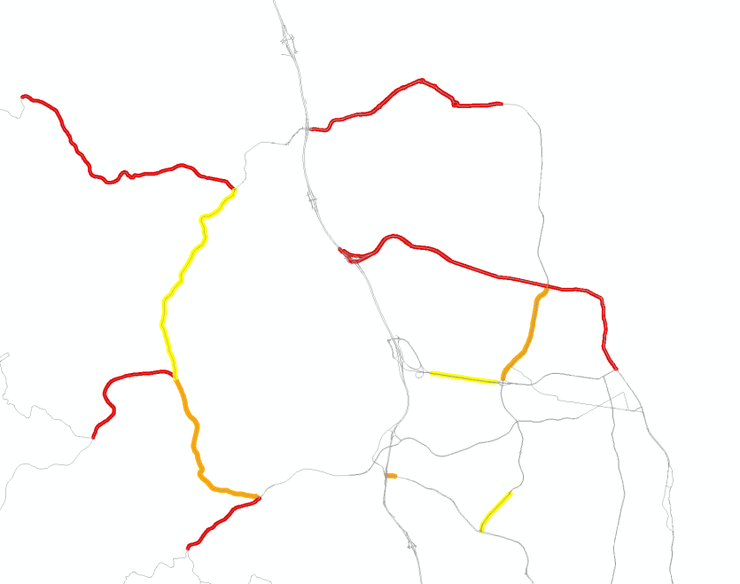
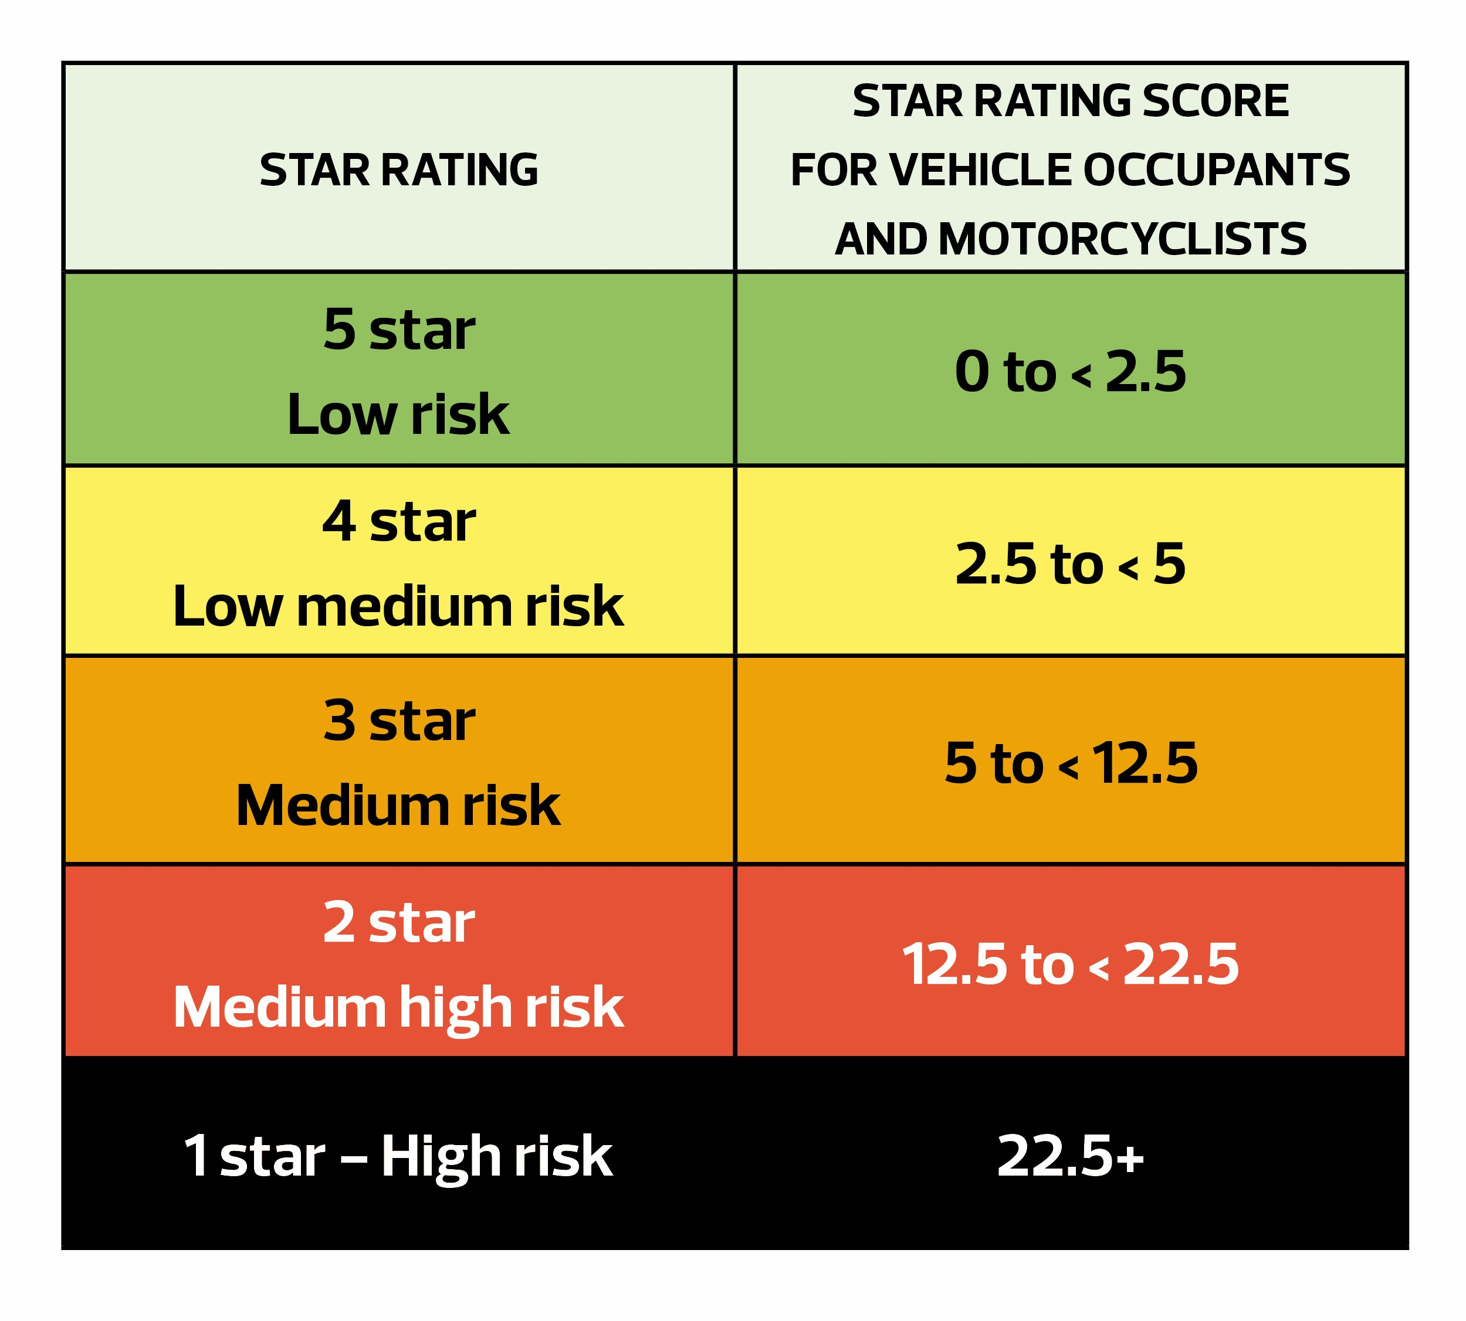

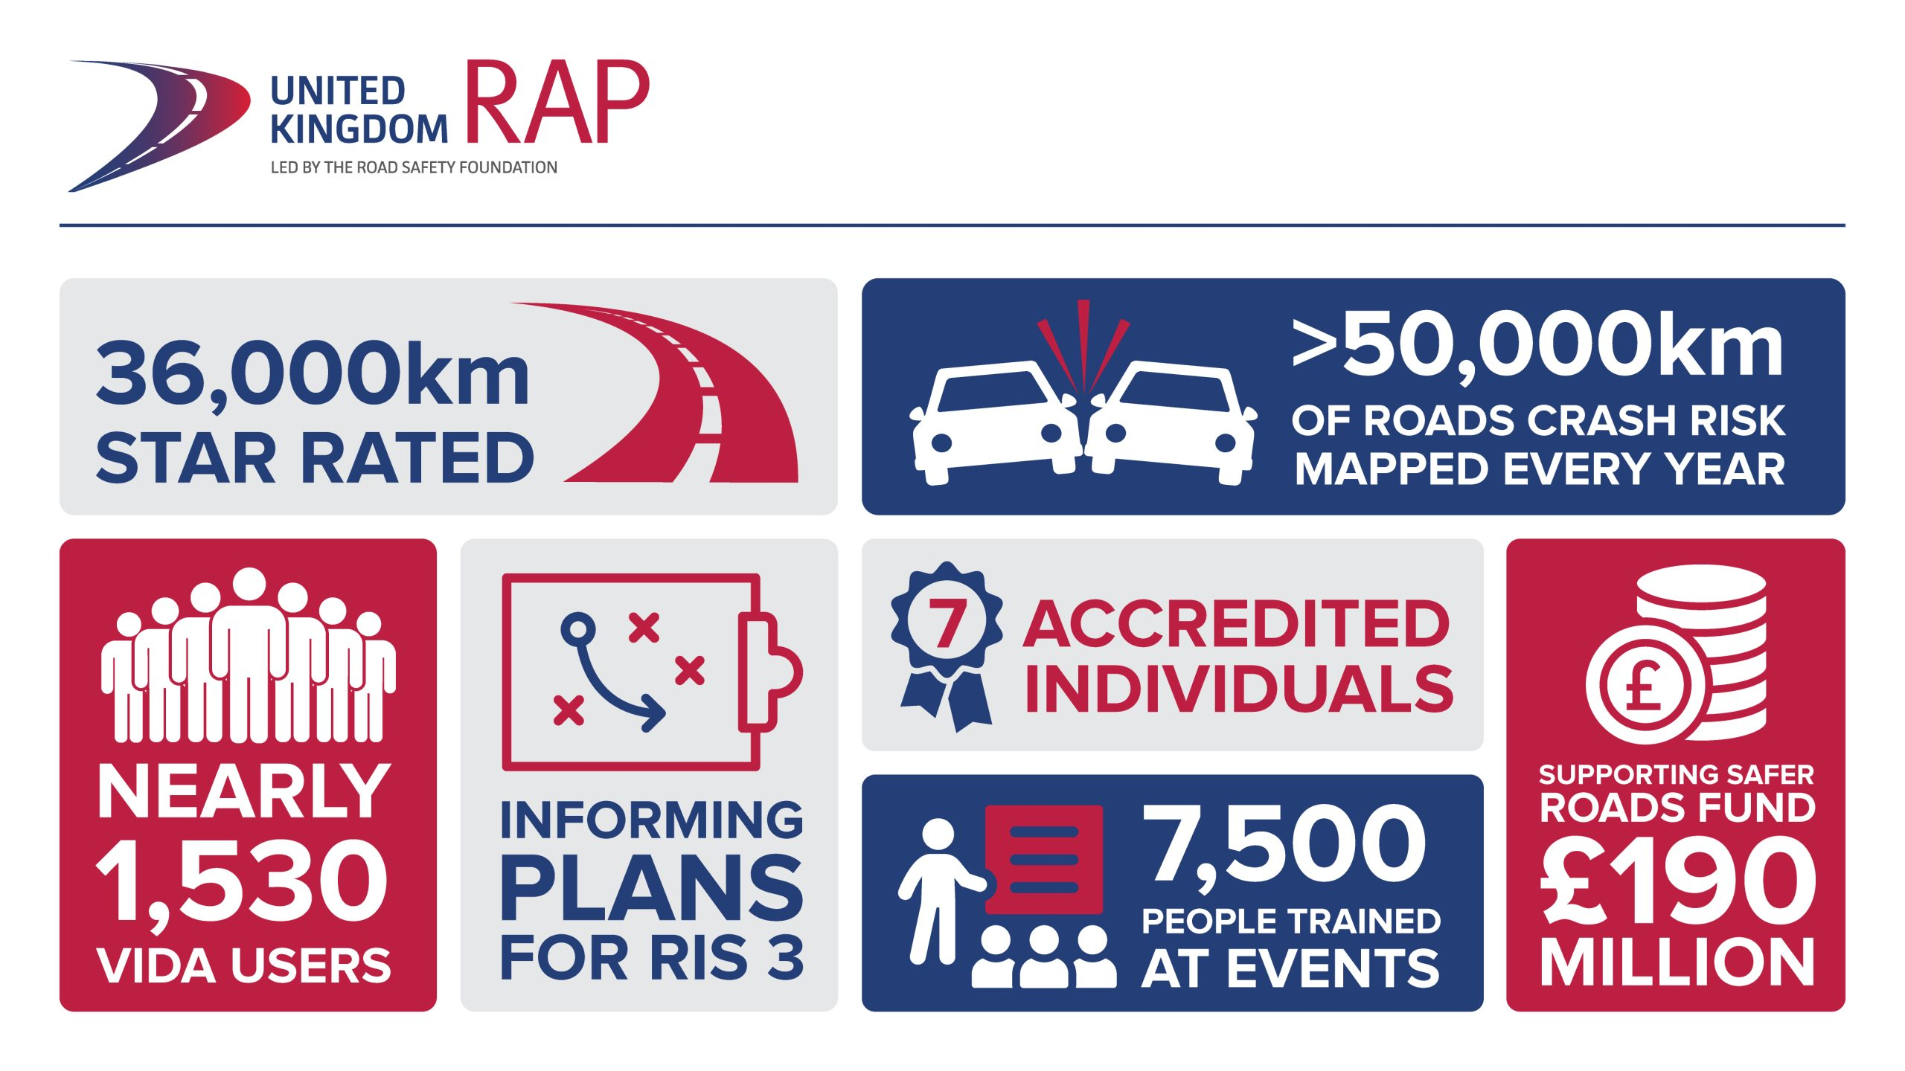


Road Assessment Programs (RAP) for safer roads

Slide 15






Importance of automation and ethical implications
Manual coding is expensive to scale
Human road coders are time-consuming to train and deploy.
AI could expand coverage faster
Automated assessment could help inspect more roads with limited budgets and limited expert capacity.
Allocation justice
If a road is under-rated, scarce safety funds may go to the wrong locations instead of the highest-risk roads.
Trust and Justification
black-box vision outputs are hard for agencies to audit, challenge, or justify in public-safety decisions.
Representation gap
The variety in road infrastructure design differs across countries.
LMIC data scarcity
Road-safety research and datasets in LMIC contexts are underrepresented, which increases the risk of unequal model performance.

Slide 16
Why does ethics matter in automated road coding?
Dashcam Evidence
Coded Road Attributes
Star Rating
Review and Intervention
Why it matters:
The output sits inside a safety-assessment workflow.
A reviewer should be able to inspect the evidence behind the code.
Weak explanations also weaken meaningful human oversight.
Core Issue:
Our target is not just an object in an image. It is a coded road attribute produced under rules. So the real issue is not only accuracy, but whether the prediction can be justified.
Bottom Line:
Explainability matters here because it makes coder–model disagreement auditable.

Slide 17
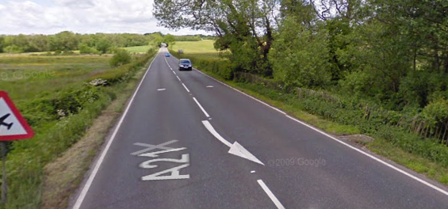
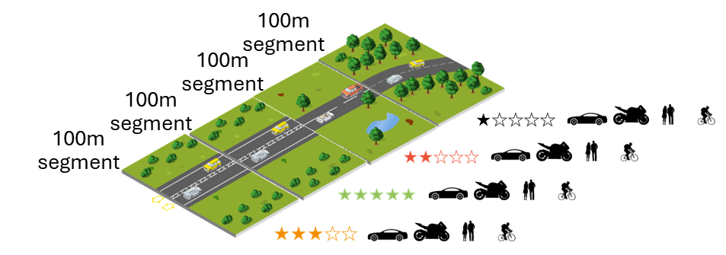
Coder-model disagreement in road assessment
Segment-level supervision
One frame may not contain the full evidence
Rule-defined labels
coding logic & visible content
Viewpoint-limited or weak visual evidence
Forward dashcam alone, not reliable
Human coding variability
Propagate into labels and decisions
single frame
limited view
Notes:
In this setting, the issue is not only prediction difficulty or accuracy, but whether a prediction can be reviewed and justified when labels are segment-based, rule-defined, visually weak, or potentially ambiguous.

Slide 18
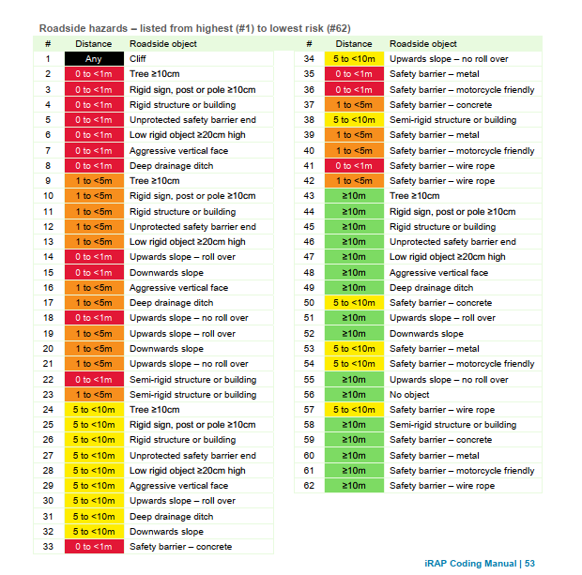
Example: Labeling Rules, Hierarchy & Distance

Slide 19
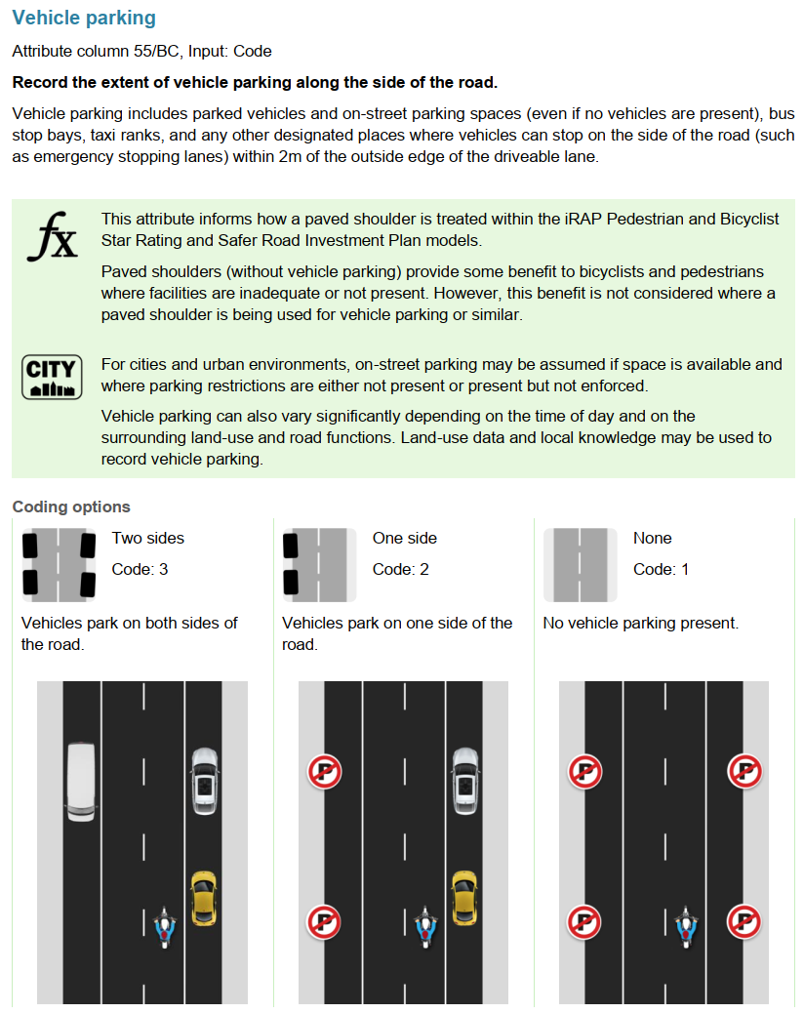
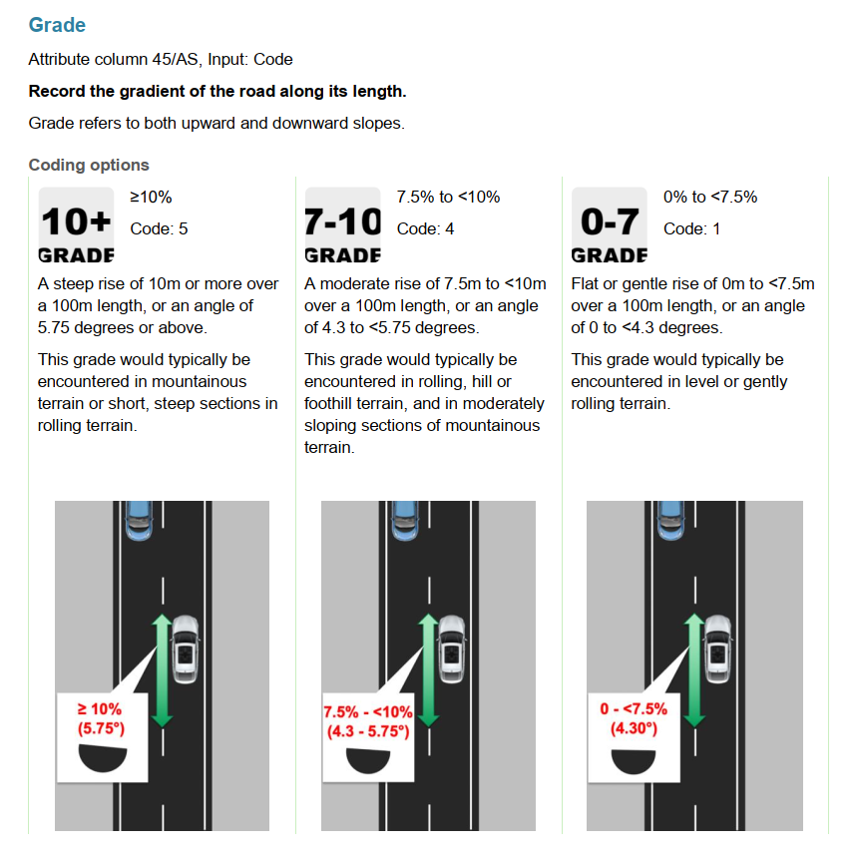
Example: Limited Visual Clues

Slide 20

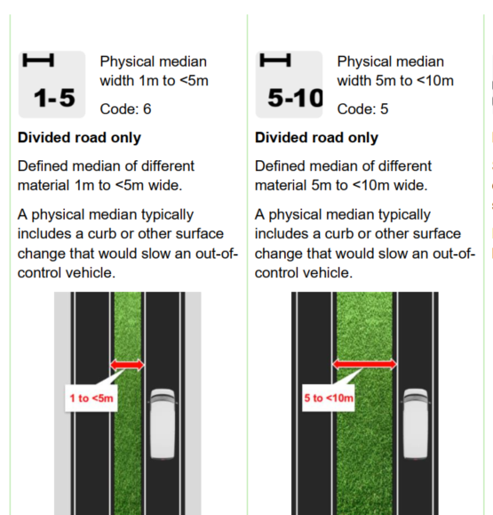
Example: Limited Visual Clues

Slide 21
Conclusions
AI and ethics must be coupled – horizontal approach
Responsibility, explainability, autonomy, justice, privacy
Methodologies to translate theory into practice
Study focus, data collection, data preprocessing, data analysis, data visualization, etc.
Ethical implications are pronounced in road assessment
Data needs particularly for LMIC, explainability

Slide 22
Thank you for listening!

