Slide 1
PhD pitch of DC3
Amirhossein Hassani
AI for Road Safety in LMICs
IVORY Consortium Meeting and Training Event
Athens, 14-15 April 2026

Slide 2
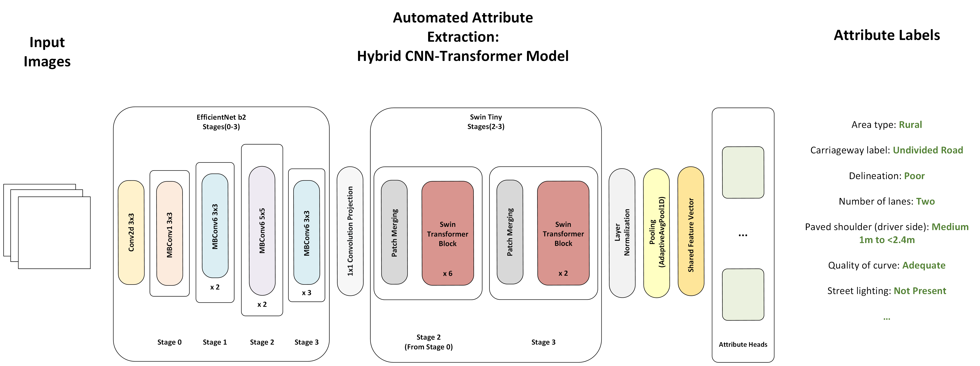



Automatic Attribute Detection for Imbalanced Datasets
EfficientNet-Swin Transformer for automated iRAP road safety attribute extraction in low- and middle-income countries. International Congress on Transportation Research 2025 (ICTR 2025). available online: DOI: 10.5281/zenodo.18822033

Slide 3
20-Frame Model | Red
20-Frame Model with Customized Loss | Orange
Our 1-Frame model | Green

Slide 4
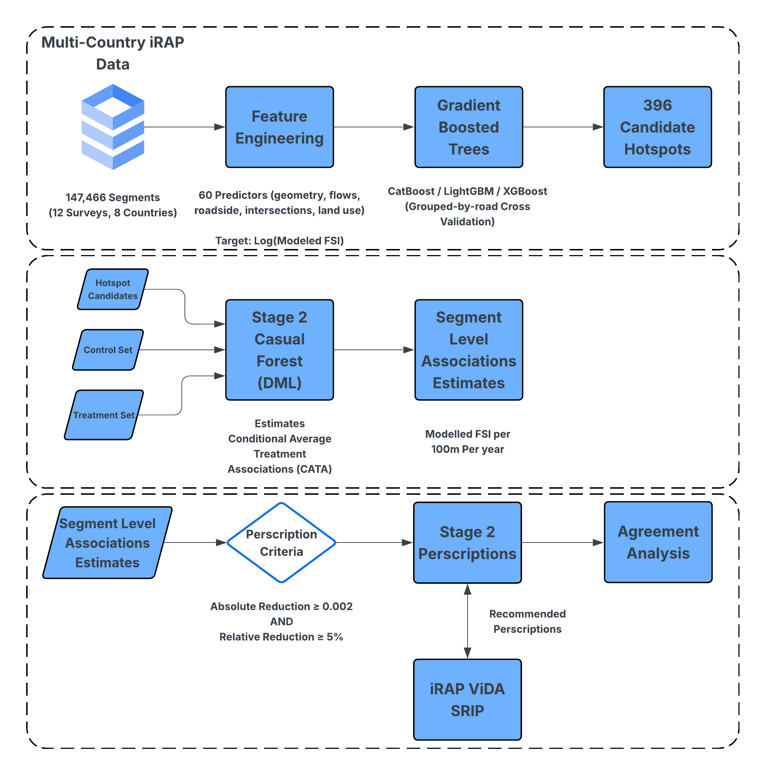
Related work: Auditing modelled road safety risk
The paper studies the modelled fatal-and-serious-injury risk surface produced by the ViDA risk engine and analyses 147,466 road segments of 100 m each from 12 surveys, grouped into four reporting groups. It uses a two-stage framework combining surrogate modelling, explainability, and treatment-level heterogeneity analysis.
It also shows how infrastructure-related attributes can be used in data-driven models to analyze modelled road risk and inform infrastructure improvement priorities.
Auditing iRAP’s ViDA risk engine: A two-stage surrogate learning and orthogonalized heterogeneity framework for modelled road safety. Infrastructures, 11(4), Article 129. Available online: 10.3390/infrastructures11040129

Slide 5
Kenya pilot attribute: severe imbalance within a single sidewalk label set Submitted into IRTAD Conference
Passenger-side sidewalk labels already show the long-tail structure that motivates targeted synthesis.
Pilot attribute and label meanings
Kenya passenger-side sidewalk distribution
Target rare class
1 = sidewalk with barrier
Reference class
4 = sidewalk 0m to <1m from road
Other dominant labels
5 = none, 7 = informal path 0m to <1m
Conference pilot
one dataset, one attribute, one rare class
Counts used for the pilot story
Class 1 total
20 images
Class 1 train / holdout
16 / 4
Class 4 reference subset
24 images
Class 1 is tiny; class 4 is a sidewalk reference class, not the head label. The pilot therefore tests a truly low-shot barrier concept.
Practical meaning
the target concept is genuinely low-resource

Slide 6
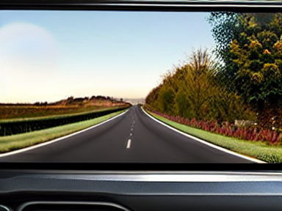

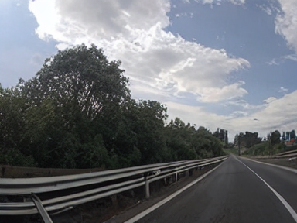
Initial result: the barrier concept becomes visible only after adaptation
The rare prompt alone remains visually close to the reference condition; the LoRA introduces the missing concept.
Group A
Group B
Group C
Reference sidewalk prompt only
Rare-class prompt only
Same rare-class prompt + LoRA
Observed in pilot: A and B look broadly similar
Observed in pilot: visible barriers appear in this condition
Core observation
The prompt-only rare-class condition (B) did not reliably separate itself from the reference condition (A). When the rare-class LoRA was added (C), barrier structures became visibly more explicit.

Slide 7
Thank you for listening!

