Slide 1
Integrating Subjective Safety Perceptions into Routing Algorithms Using
Infrastructural Features
Akanksha Agarwal, Davy Janssens, Tom Bellemans
WP6- AI for Proactive Infrastructure Safety Management
Mid-Term Conference
15th April 2026 – Athens, Greece

Slide 2
From Reactive to Proactive: Rethinking Infrastructure Safety
Three challenges driving the need for a new approach
01
02
03
Reactive, Not Preventive
Incomplete Objective Data
The Perception Gap
Most safety interventions today kick in after crashes have already happened. We look at crash records, identify hotspots, and then act. The problem is obvious — by definition, we’re always one step behind.
Crash databases don’t tell the whole story. They miss near-misses, underreport minor incidents, and say nothing about the road characteristics — like poor lighting or missing sidewalks — that make a segment risky in the first place.
A road can have zero recorded crashes and still feel unsafe to walk or cycle on. Research shows it’s this subjective feeling — not the statistics — that actually shapes how people choose their routes.

Slide 3
Research Objective & Data
Can we generate routes that are experienced as safe — not just statistically safe — by using the infrastructural characteristics of a road network as predictors of perceived safety?
THE APPROACH
THE DATA
1
Train a predictive model
Parents of school-age children across Flanders, Belgium, were asked to mark road segments as safe or unsafe based on their personal experience — not on crash records or traffic stats.
Use infrastructural features — road width, lighting, surface quality, separation from traffic — to predict how safe a road segment feels to users.
2
Score every segment
Apply the model across an entire road network to assign perceived safety scores to each link.
Source
Route2School (R2S) and OpenStreetMap (OSM)
Features
Infrastructural attributes (road geometry, surface, facilities, environment)
3
Feed scores into a router
Modify the routing cost function so it can generate routes that prioritise experienced safety over shortest travel time.
Label
3-Classes: Safe, Occasionally_Unsafe, and Unsafe

Slide 4
The AI Framework: A Semi-Supervised Model
How AI bridges the gap between limited labeled data and network-wide safety prediction
1
2
3
4
5
Input Data
Denoising Autoencoder
Learned Feature Representation
Supervised Model Training
Predictions
A combination of Safety labels from R2S and infrastructural attributes from OSM as features.
Apply self-supervised pre-training to learn structure from unlabeled, incomplete input variables.
A reduced, information-dense feature set from raw inputs.
Use the extracted feature set as the input for safety classification.
A subjective safety label for all road segments in the network.
Only a subset of road segments have user ratings — the model learns from these to predict perceived safety across the entire network, turning sparse subjective data into full coverage.

Slide 5
From Predictions to Safe Routes
Translating model output into routing decisions
Rather than using the predicted safety labels directly, we use the model's class probabilities to compute an expected safety score per segment. This score is integrated with the existing segment weights in OSRM. Tunable penalties then control how aggressively the router avoids unsafe segments — essentially a dial between fastest and safest.
Class Probabilities
Safety Score
OSRM Integration
The model outputs P(Safe), P(Occasionally_Unsafe), and P(Unsafe) for each segment — the likelihood of belonging to each safety class.
These probabilities are combined into a single continuous score, giving the router a more nuanced input than a hard label.
The score modifies each segment’s traversal cost. An additional penalty parameter controls how much emphasis is placed on safety over speed.
The result: for any origin-destination pair, the router can generate both the fastest and a number of safe routes.

Slide 6
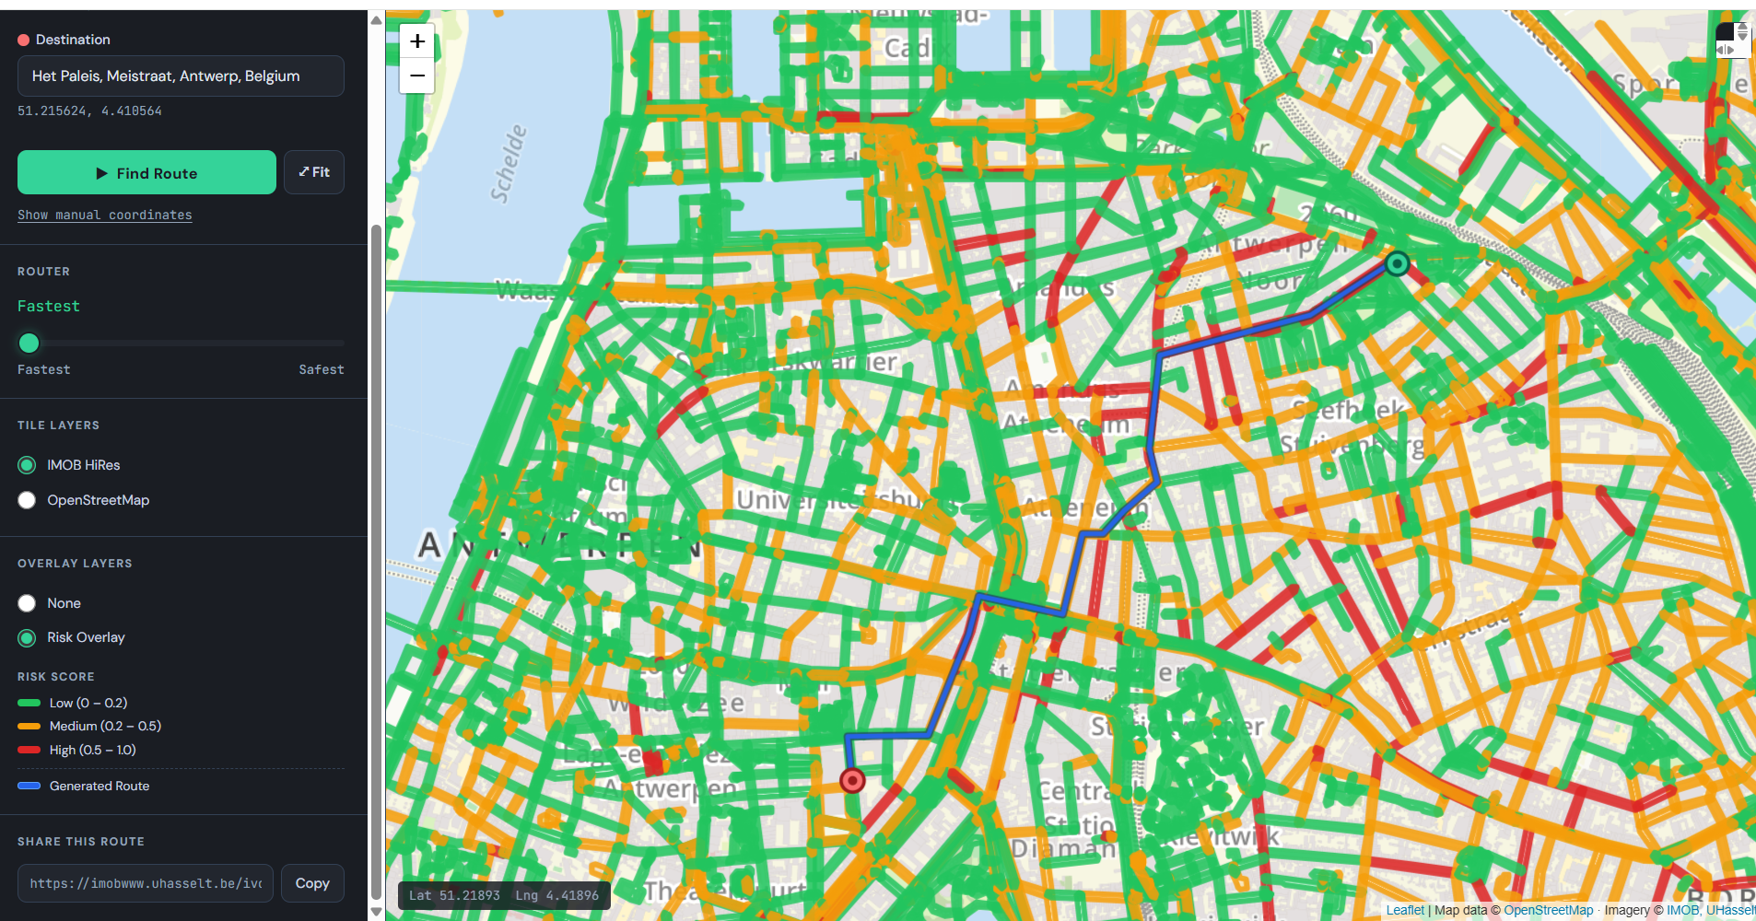
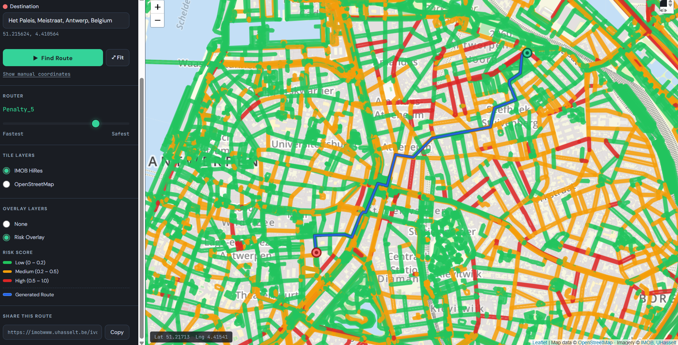
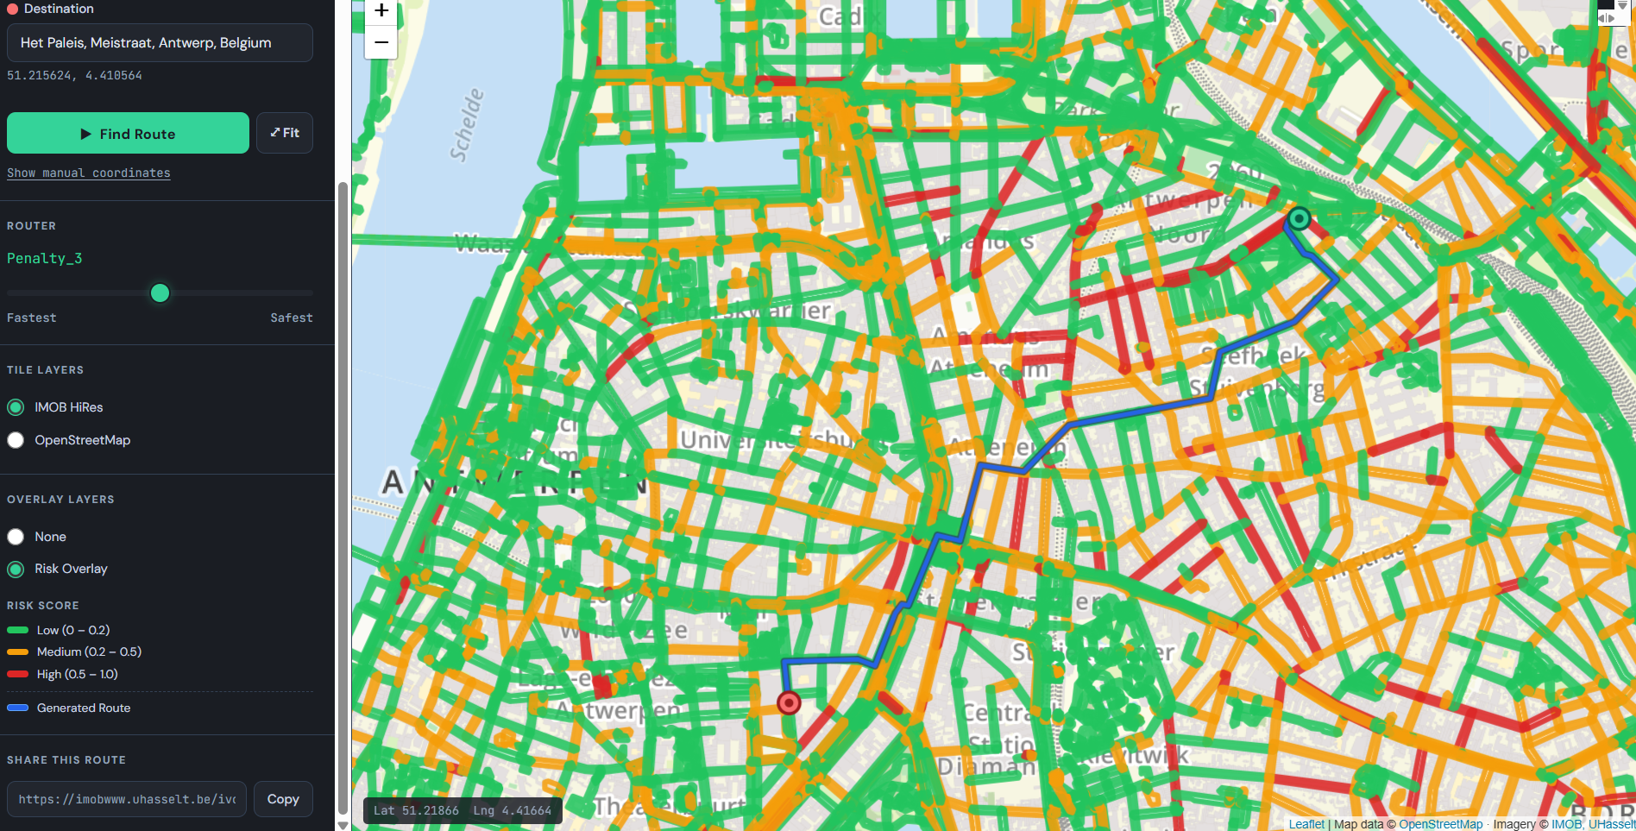
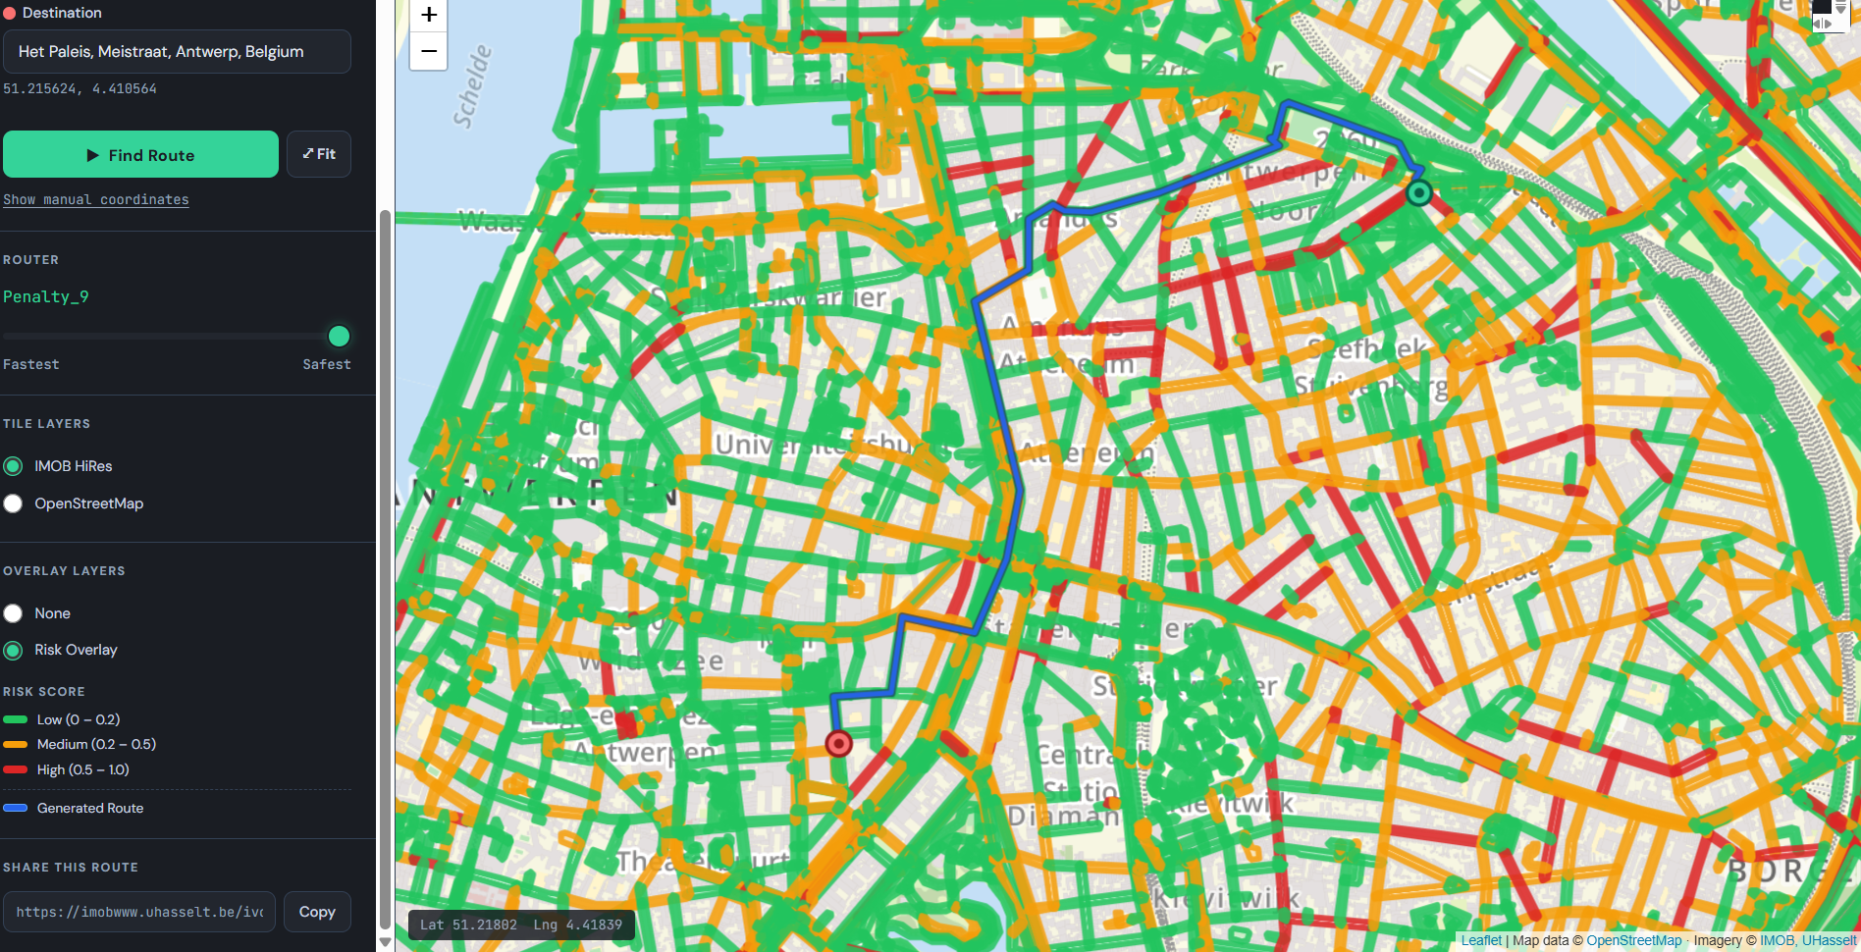
Safe Router in Action
Comparing fastest vs. safest routes for the same origin-destination pair
FASTEST ROUTE
SAFE ROUTE-2
SAFE ROUTE-1
SAFE ROUTE-3

Slide 7
Current Limitations
Where the work stands and what still needs solving
Class Imbalance
CLASS DISTRIBUTION
The dataset is heavily skewed — most segments are rated as safe, making the unsafe classes a minority. The model achieves reasonable precision, but recall for minority classes remains low, meaning it misses a portion of segments users would perceive as unsafe.
65%
Missing Data
Not all segments have complete attribute data. With over 300 infrastructural features per segment, gaps are inevitable and introduce noise that limits the model’s reliability in certain areas of the network.
17%
18%
Safe
Occasionally_Unsafe
Unsafe
Model Generalisability
The model has been trained on one region — we still need to test whether it generalizes well to other areas with different road characteristics and user expectations.
FEATURE COMPLEXITY
300+
infrastructural attributes per segment — not all consistently available across the network

Slide 8
Conclusion
NEXT STEPS
Model Optimisation
Safe School Routes
Feedback Loop
Personalisation
KEY TAKEAWAYS
Safe routing brings a missing layer to proactive infrastructure safety — it shifts the focus from reacting to crashes to preventing uncomfortable and risky experiences before they occur.
By grounding route decisions in how people actually perceive roads, this work connects infrastructure assessment directly to everyday mobility choices.
The working prototype demonstrates that integrating subjective safety into routing is feasible — opening the door to safety-aware navigation at scale.

Slide 9
Thank you!
Akanksha Agarwal
Transportation Research Institute (IMOB), Hasselt University
Contact: akanksha.agarwal@uhasselt.be

